Slide 1

REFRAMING THE REGIONS
a framework for local master planning in regional communities
Sophia Dow

Slide 2

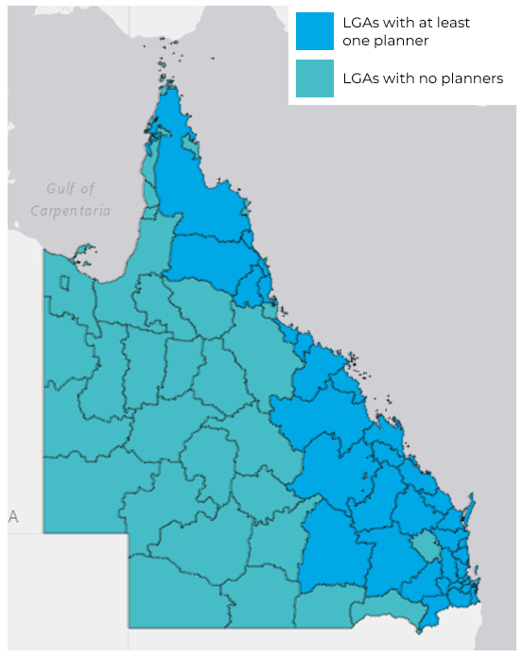
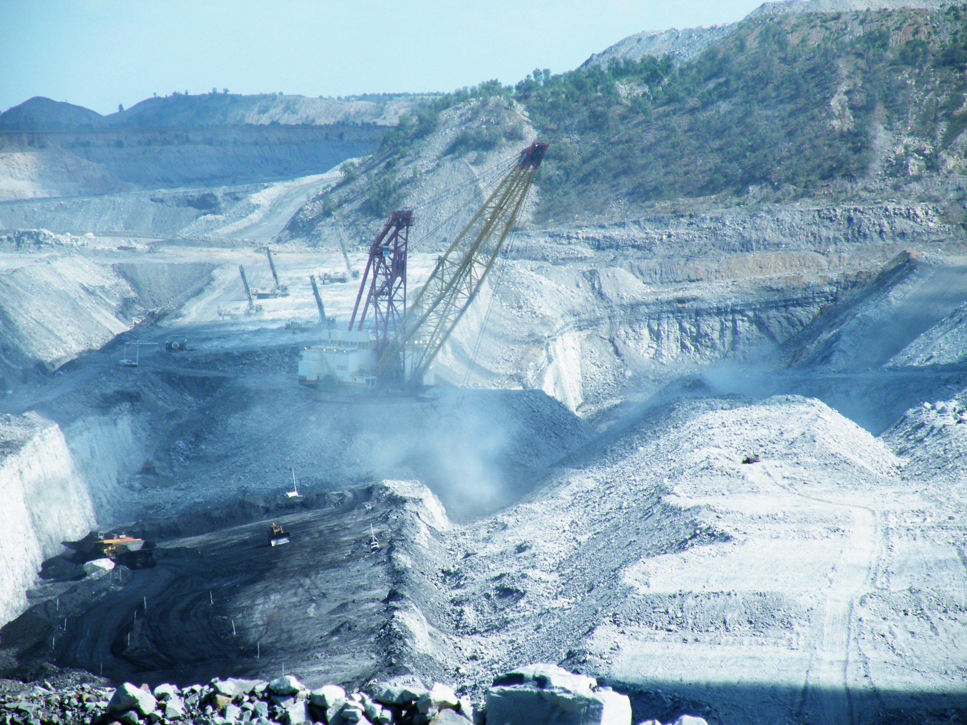
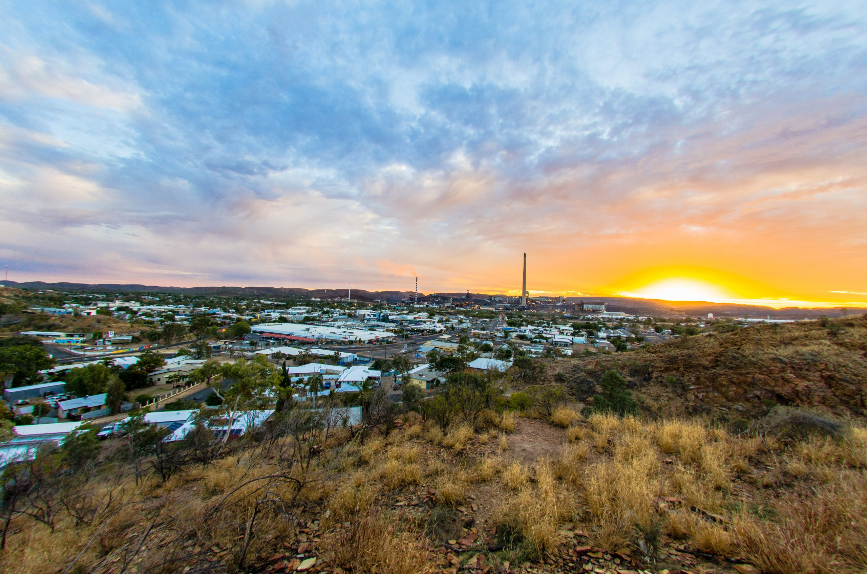
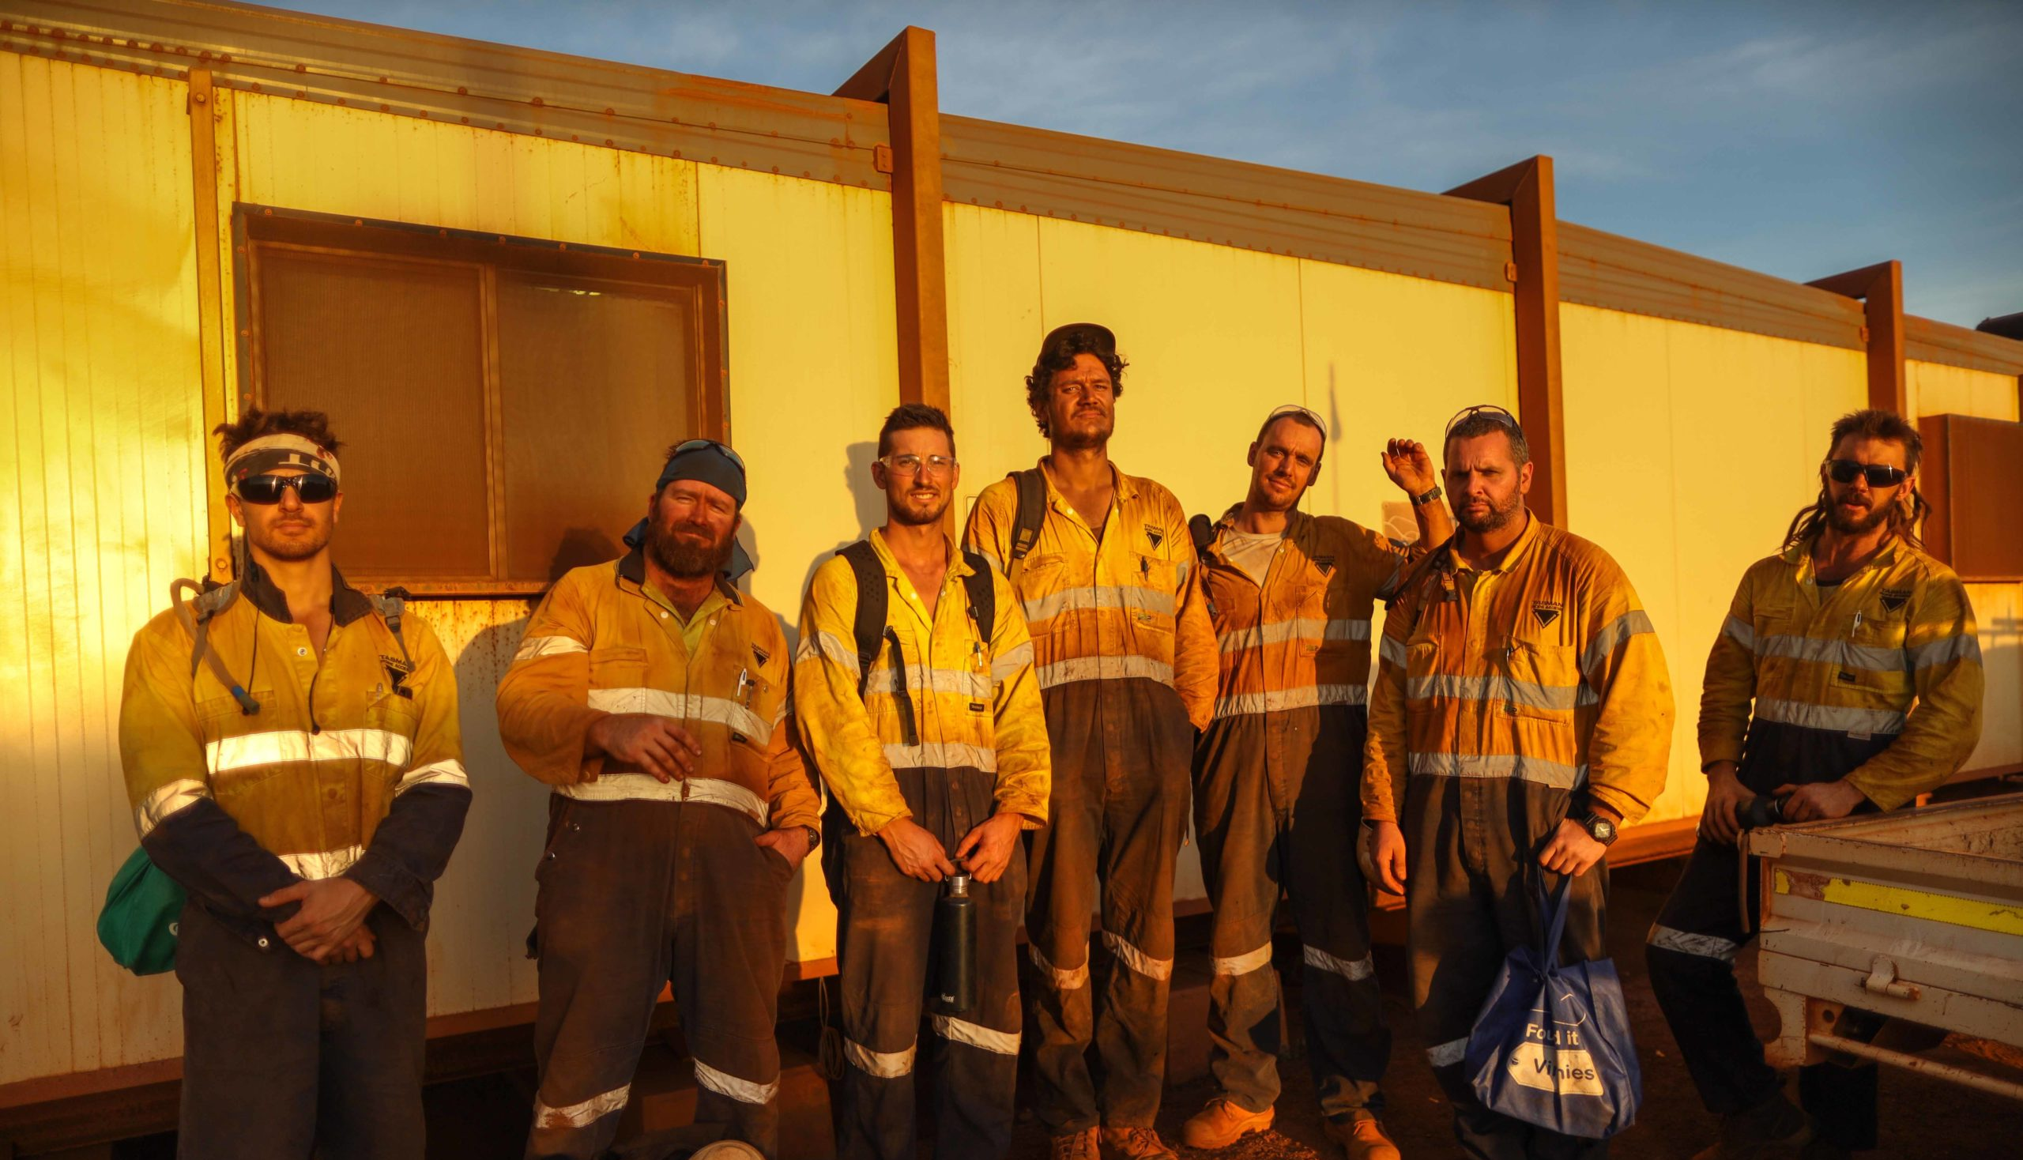
CHALLENGES FOR THE REGIONS
Increasingly transitory workforces & temporary populations
Housing pressures including supply, diversity and affordability
Housing developed, owned & exclusively used by private companies, and not necessarily housing permanent residents
Balancing large private companies’ interests & local communities’ needs, and rising environmental values
Large transport and infrastructure projects catering to private companies’ interests over communities’ needs
Volatile primary economies – suffer the greatest in a bust, but reap the least in a boom
Increasing withdrawals of essential services
Spatial distribution of Queensland planners in 2021
(ABS 2021; Kinner & Odgen 2014; Chesire et al. 2014; Jacques & Street 2022; Mayere & Donehue 2014; Waterson & André 2022; Waterson & Katsaras 2023; Commonwealth of Australia 2018; C Change Sustainable Solutions 2012; Babacan & Dale 2019)

Slide 3

PROPOSED SOLUTION: LOCAL MASTER PLANNING
An adaptable local master plan framework/structure that prioritises collaboration between planners and community
Building upon existing initiatives, e.g., Local Housing Action Plans
“Consider master planning of identified options to ensure resilient development meets community expectation of how its town acknowledges its heritage”
Guided by best practice approaches:
Roxbury Strategic Master Plan (2000 – present)
Montgomery County Community Master Plans
Locality, UK
Cody Rouge & Warrendale Youth-Centric Neighborhood Framework (2019 – present)
Our Legacy, Our Community: A Renewed Vision for North Tulsa (2021 – present)
(DSDILGP 2022; Boston Redevelopment Authority 2004; Montgomery Planning 2023; Chetwyn 2018; City of Tulsa 2022; Planning & Development Department 2022)

Slide 4
SUGGESTED LOCAL MASTER PLAN STRUCTURE
1
Principles and Values
Each component of the framework makes key recommendations for the creation of the master plan, and how it can serve a productive role as a planning tool
The framework steps out the key components to deliver a successful initiative from the outset to its implementation
Intended to work in tandem with planning schemes through the implementation of local plan codes
Supplemented by strong communication and collaboration networks between councils and communities, and transparency
Strongly targets the social components of sustainability as a solution led by community engagement and participation from its commencement to implementation
2
Context
3
Themes: Goals and Strategies
Theme 1
Goals
Strategies
Theme 2…
4
Points of Growth
5
Implementation
6
Governance and Responsibilities
7
Engagement Summary

Slide 5
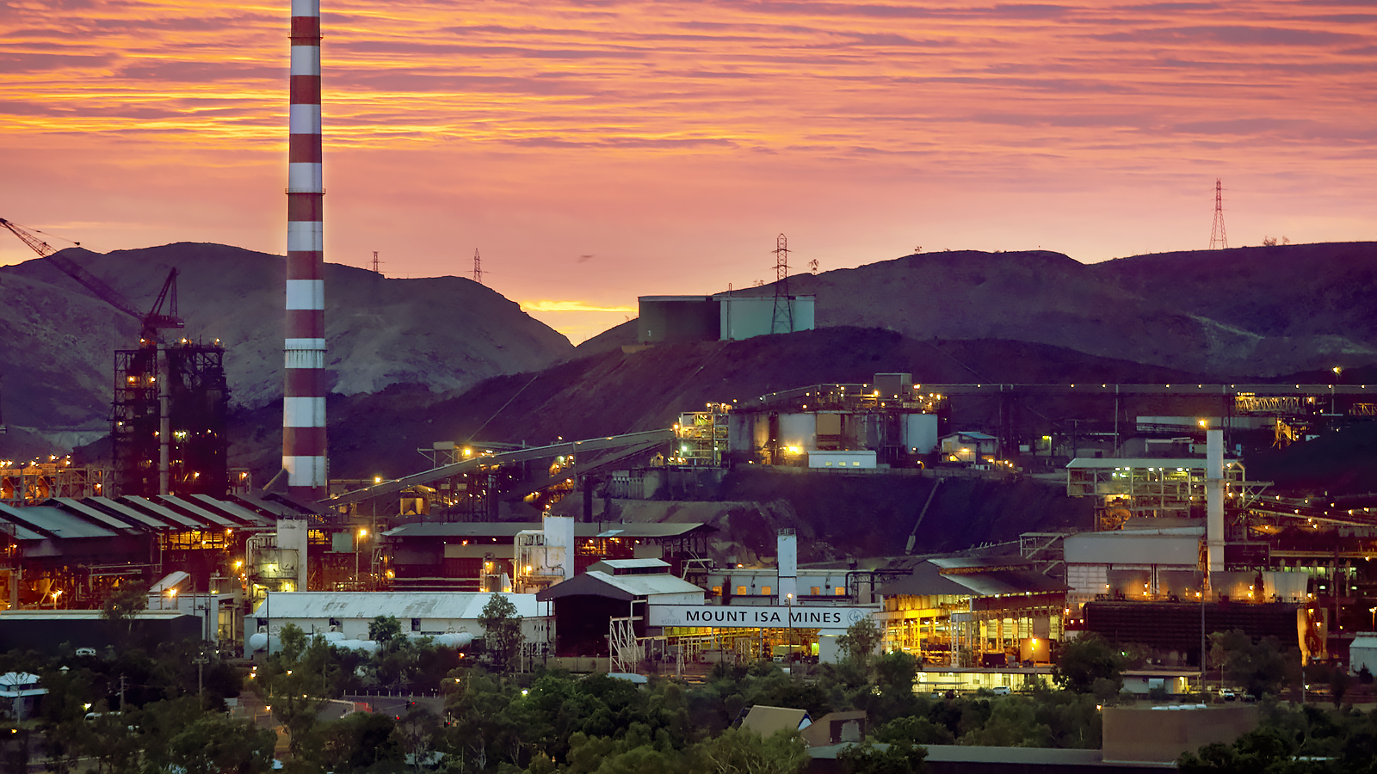


SUGGESTED LOCAL MASTER PLAN STRUCTURE
1
Principles and Values
Guided by stakeholder feedback & community engagement
Serve to guide the themes for goals and strategies
The primary drivers for the local master plan
Consideration of contextual applicability, priorities and expectations
2
Context
3
Themes: Goals and Strategies
Theme 1
Goals
Historical, social, economic, environmental, and cultural context
Use of various sources including archival material, community input, word-of-mouth history
Highlight the key aspects that underpin local identity, employment, and growth
Strategies
Theme 2…
4
Points of Growth
5
Implementation
6
Governance and Responsibilities
7
Engagement Summary

Slide 6
SUGGESTED LOCAL MASTER PLAN STRUCTURE
1
Principles and Values
Minimum one theme per component of sustainability: social, economic, environmental
Specific to local contexts, and justified by key trends & insights
Guided by Principles and Values and community sentiment
Set out goals for short-term, medium-term and long-term achievement
Strategies describe the necessary processes to achieve the goals, and overall theme
2
Context
3
Themes: Goals and Strategies
Theme 1
Goals
Strategies
Theme 2…
Key areas identified for growth: spatially and conceptually
Will align with many of the goals, though to a more specific extent
Establishes priorities for growth and change within communities
Identifying these points and areas of growth serves to guide further policies, precinct planning, investment
4
Points of Growth
5
Implementation
6
Governance and Responsibilities
7
Engagement Summary

Slide 7
SUGGESTED LOCAL MASTER PLAN STRUCTURE
1
Principles and Values
Integration with other planning instruments
Implementation across short-term, medium-term and long-term horizons
Identifying review and renewal periods
2
Context
3
Themes: Goals and Strategies
Identification of key roles necessary to implement the local master plan, and authority bodies
Allocate responsibilities to roles
Provide guidance on how communities can stay informed and who facilitates community engagement
Theme 1
Goals
Strategies
Theme 2…
4
Points of Growth
Summary of all engagement undertaken and stakeholders involved
Reflection on methods, tools and effectiveness
A necessity to foster positive community relationships and transparency
5
Implementation
6
Governance and Responsibilities
7
Engagement Summary

Slide 8
CONCLUSION
Local Master Plan Structure
Creating a “blueprint for progress”
Effective planning and governance are essential conditions to support growth and sustainability
Planning must take a central role through strategic initiatives to reframe the potential of regional communities
The proposed local master plan structure aims to enhance stakeholder collaboration and community engagement to deliver better planning outcomes for regional places, ensuring they are well-planned, prosperous, resilient and sustainable communities
1
Principles and Values
2
Context
3
Themes: Goals and Strategies
Theme 1
Goals
Strategies
Theme 2…
4
Points of Growth
5
Implementation
6
Governance and Responsibilities
7
Engagement Summary
(Nicklin 1964, p. 240)

Slide 9
REFERENCE LIST
Australian Bureau of Statistics [ABS] 2021, Occupation by Place of Work, Census of Population and Housing, Australia, Dataset, viewed 20 September 2023, <https://tablebuilder.abs.gov.au/webapi/jsf/dataCatalogueExplorer.xhtml>.
Babacan, H & Dale, A 2019, Emerging rural and regional policy considerations for Queensland: an overview paper, Rural Economies Centre of Excellence, Toowoomba, viewed 28 October 2023, <https://www.ruraleconomies.org.au/media/1167/recoe-22-policy-issues-overview-paper-march-2019.pdf>.
Boston Redevelopment Authority 2004, The Roxbury Strategic Master Plan, Boston Redevelopment Authority, Boston, viewed 22 September 2023, <https://www.bostonplans.org/getattachment/a5de5a42-9d9a-454f-b4c8-6aedbd53764d>.
C Change Sustainable Solutions 2012, BBCG Project Housing Impacts Study, BHP Billiton Mitsubishi Alliance, viewed 28 October 2023, <https://www.statedevelopment.qld.gov.au/__data/assets/pdf_file/0012/34131/bbcg-project-housing-impacts-plan.pdf>.
Cheshire, L, Everingham, JA & Lawrence, G 2014, ‘Governing the impacts of mining and the impacts of mining governance: Challenges for rural and regional local governments in Australia’, Journal of Rural Studies, vol. 36, pp. 330-9.
Chetwyn, D 2018, Neighbourhood Plans Roadmap, Locality, viewed 23 September 2023, <https://neighbourhoodplanning.org/wp-content/uploads/NP_Roadmap_online_full.pdf>.
City of Tulsa 2022, Our Legacy, Our Community: A Renewed Vision for North Tulsa, master plan, City of Tulsa, Tulsa, Oklahoma, viewed 28 October 2023, <https://www.ourlegacytulsa.org/>.
Commonwealth of Australia 2018, Regions at the Ready: Investing in Australia’s Future, House of Representatives Select Committee on Regional Development and Decentralisation, Canberra, viewed 28 October 2023, <https://www.infrastructure.gov.au/sites/default/files/migrated/regional/publications/files/RegionsattheReadyInvestinginAustraliasFuture.pdf>.
Department of State Development, Infrastructure, Local Government and Planning [DSDILGP] 2022, Local housing action plans, Queensland Government, viewed 23 September 2023, <https://www.statedevelopment.qld.gov.au/planning/local-housing-action-plans>.
Jacques, O & Street, J 2022, ‘Regional Queensland is under pressure: Here are three things it needs to survive’, ABC News, 27 March, viewed 22 September 2023, <https://www.abc.net.au/news/2022-03-27/regional-queensland-infrastructure-australia-report/100939520>.
Kinnear, S & Ogden, I 2014, ‘Planning the innovation agenda for sustainable development in resource regions: A central Queensland case study’, Resources policy, vol. 39, pp. 42-53.
Locality n.d., New homes, green space and a sense of price – this is what neighbourhood planning can achieve, viewed 23 September 2023, <https://neighbourhoodplanning.org/case_study/uppingham/>.
Mayere, S & Donehue, PA 2014, ‘Perceptions of land-use uncertainty in Queensland’s resource-based regions’, Australian Planner, vol. 51, no. 3, pp. 212-22.
Montgomery Planning 2023, Communities, Maryland-National Capital Park and Planning Commission, Montgomery County, MD viewed 23 September 2023, <https://montgomeryplanning.org/planning/communities/>.
Nicklin, F 1964, ‘Planning for the future in Queensland’, Royal Australian Planning Institute Journal, vol. 2, no. 8, pp. 237-40.
Planning & Development Department 2022, Cody Rogue & Warrendale Youth-Centric Neighbourhood Framework, City of Detroit, Michigan, viewed 28 October 2023, <https://codyrougeandwarrendaleplan.org/>.
Waterson, L & André, J 2022, ‘Regional Queensland’s ‘troubling’ healthcare situation a result of bureaucracy, leaders say’, ABC News, 14 April, viewed 28 October 2023, <https://www.abc.net.au/news/2022-04-14/queensland-rural-health-crisis/100990140>.
Waterson, L & Katsaras, J 2023, ‘Mass exodus of regional bank branches across Australia leaves residents seeking solutions’, ABC News, 19 May, viewed 28 October 2023, <https://www.abc.net.au/news/2023-05-19/senate-inquiry-into-regional-bank-branch-closures-solutions/102365588>.
Image credits:
https://cqroc.org.au/banana-shire/
https://discovermountisa.com.au/visitor-info/about-mount-isa/
https://www.glencore.com.au/operations-and-projects/qld-metals/operations/mount-isa-mines
https://www.yurika.com.au/fifo-connected/
https://frrr.org.au/heartbeat/

