Slide 1
Group Members:
Megha Subodh
Meghana Dinesh

Slide 2

A CITY FILLED WITH HOMES, NOT JUST BUILDING BLOCKS

Slide 3
BUILDING HOMES THAT EMBRACE EVERYONE
INCLUSIVE HOMES PROGRAM (IHP)

Slide 4
THE CURRENT SCENARIO
of Queenslanders have been reported with a profound disability
19.1%
78.24%
of the disabled community in Queensland live with others
25.32%
of the disabled community in Queensland Rent houses
18.1%
are owners with a mortgage
rent with state or territory housing authority
3.5%
Live in cared accomodations

Slide 5

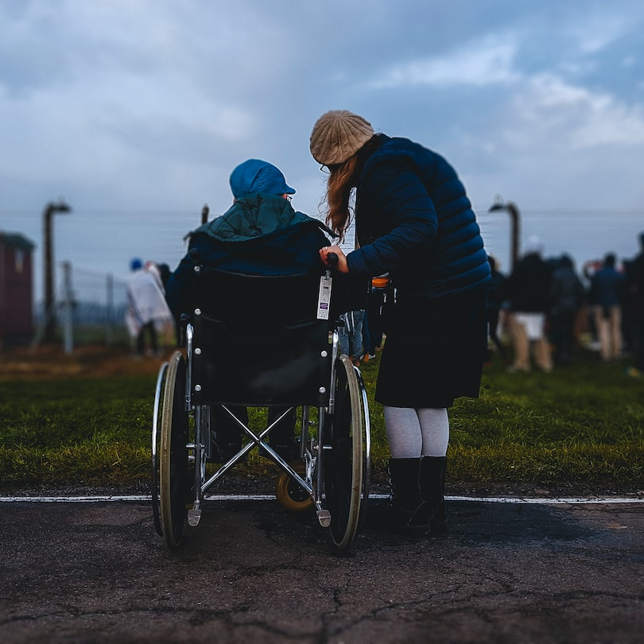
BARRIERS
Dependency
forced into co-tenancy arrangements in cared accommodations/social housing projects
Have to live with Family members all the time
Cost
Modifying houses with no accessibility features become very expensive
The main source of income for the disabled community are government pension and wages
Government funding programs like the NDIS start providing limited funding
Supply and Demand
Forced to move to rural or remote communities seeking affordable housing that is accessible/ can be easily modified.
Forced to adjust in any place that can be accessible and affordable even if their other needs are not met.
NDIS will eventually start running out of funds

Slide 6
CREATING HOMES, NOT JUST HOUSES, FOR EVERY INDIVIDUAL'S UNIQUE ABILITY.
Empowering the disabled community with spaces that truly feel like home, tailored to their unique needs and desires, rather than settling for merely accessible and budget-friendly options
.
.
.
.
ACCESSIBILE
AFFORDABLE
HOME
PERSONAL COMFORT
VISION

Slide 7
WHAT CAN BE DONE?
01
02
INCREASE THE SUPPLY OF ACCESSIBLE HOUSES
PROVIDE EASY TO BUILD, AFFORDABLE HOUSES THAT CAN BE BUILT ANYWHERE
Accessibility should be more than a mere feature—it should be a commitment embedded in every design plan. This expands the range of choices available to the disabled community, especially for those looking to rent. It ensures they aren't confined to a limited selection, allowing them to find a living arrangement that truly meets their needs and preferences
This ensures that individuals from the disabled community have the flexibility to select a location that suits their preferences, whether it be proximity to family or easy access to public transport, all while being cost-effective and efficient.
IHP POINT - INCENTIVE SYSTEM
IHP AFFORDABLE HOUSING MODULE

Slide 8
IHP POINT SYSTEM
Door widths should be 36"-42" | Compulsory to follow, 35% penalty if not followed
Ramp access or elevators in the entrance | Compulsory to follow, 35% penalty if not followed
Corridor widths - 42", providing enough turning radius | Compulsory to follow, 35% penalty if not followed
Acessible Outdoor green spaces, Visual connect with green | Compulsory to follow, 35% penalty if not followed
Clear evacuation routes, with tactile,visual and auditory wayfinding mechanisms | Compulsory to follow, 35% penalty if not followed
Zero threshold entryways
Non-slip, low-pile carpeting or hard flooring
Adjustable height beds
Acessible storage solutions
Roll-in showers with grab bars and handheld showerheads.
Non-slip, low-pile carpeting or hard flooring
Accessible sinks with knee clearance and lever handles
Kitchen Counters at varying heights
Easily accessible light switches and outlets.
Open plan and multifunctional living spaces
Safety features in ramps and stairs
Enable future adjustments
36" - 42" space provision around the bed
Tactile Flooring Markers
Acoustic considerations ( Noise barriers, etc.)
Biophillic design elements in the interiors
Wellness hubs/ spaces for improving mental health
Adaptive smart lighting for customizable illumination.
Automated Doorways and Entrances
Braille labels and wayfinding methods
sound systems that allow residents to adjust ambient sounds, providing comfort and reducing sensory overload.
Tactile simualtions
Visual and auditory Emergency Alerts

Slide 9
FOR PLOTS IN SUBURBS/ FAR AWAY FROM PUBLIC TRANSPORTATION :
FOR PLOTS IN THE CITY/ CLOSE TO PUBLIC TRANSPORTATION :
INCENTIVES
POINTS | INFRA-STRUCTURE DISCOUNT
60 -70 | 40%
50-60 | 35%
40-50 | 30%
30-40 | 25%
20-30 | 20%
10-20 | 15%
POINTS | INFRA-STRUCTURE DISCOUNT
71-75 | 60%
66-70 | 55%
61-65 | 50%
56-60 | 45%
51-55 | 40%
46-50 | 35%
41-45 | 30%
36-40 | 25%
31-35 | 20%
26-30 | 15%
21-25 | 10%
10-20 | 5%
If a Developer introduces an original solution that enhances accessibility and inclusivity, and it proves to be beneficial, they will be eligible for upto 20% additional infrastructure incentive. To apply, they need to provide the following details:
Description of the design element.
Explanation of how it enhances adaptability.
Estimation of associated installation costs.
The developer will be rewarded based on the effectiveness and creativity of the idea.

Slide 10
HOW IT WORKS?
The IHP points-incentive table determines points based on the following criteria:
The extent of benefit to the broader disabled community.
The level of difficulty for future installation or construction as a modification.
The associated construction or implementation costs.

Slide 11
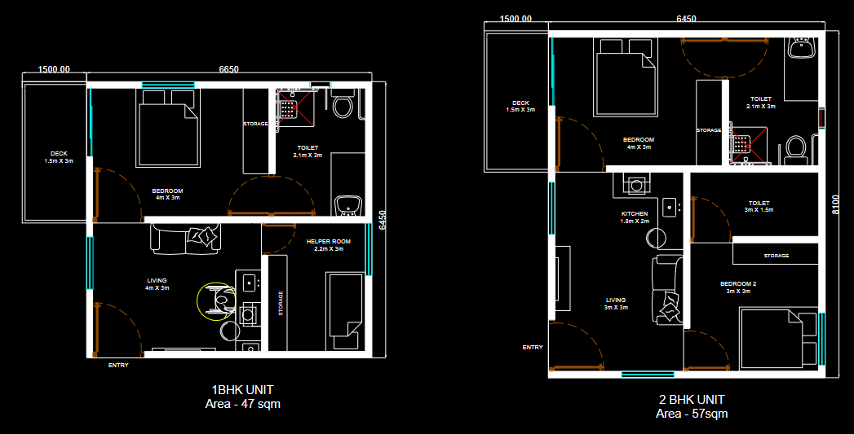
IHP AFFORDABLE HOUSING MODULE

Slide 12
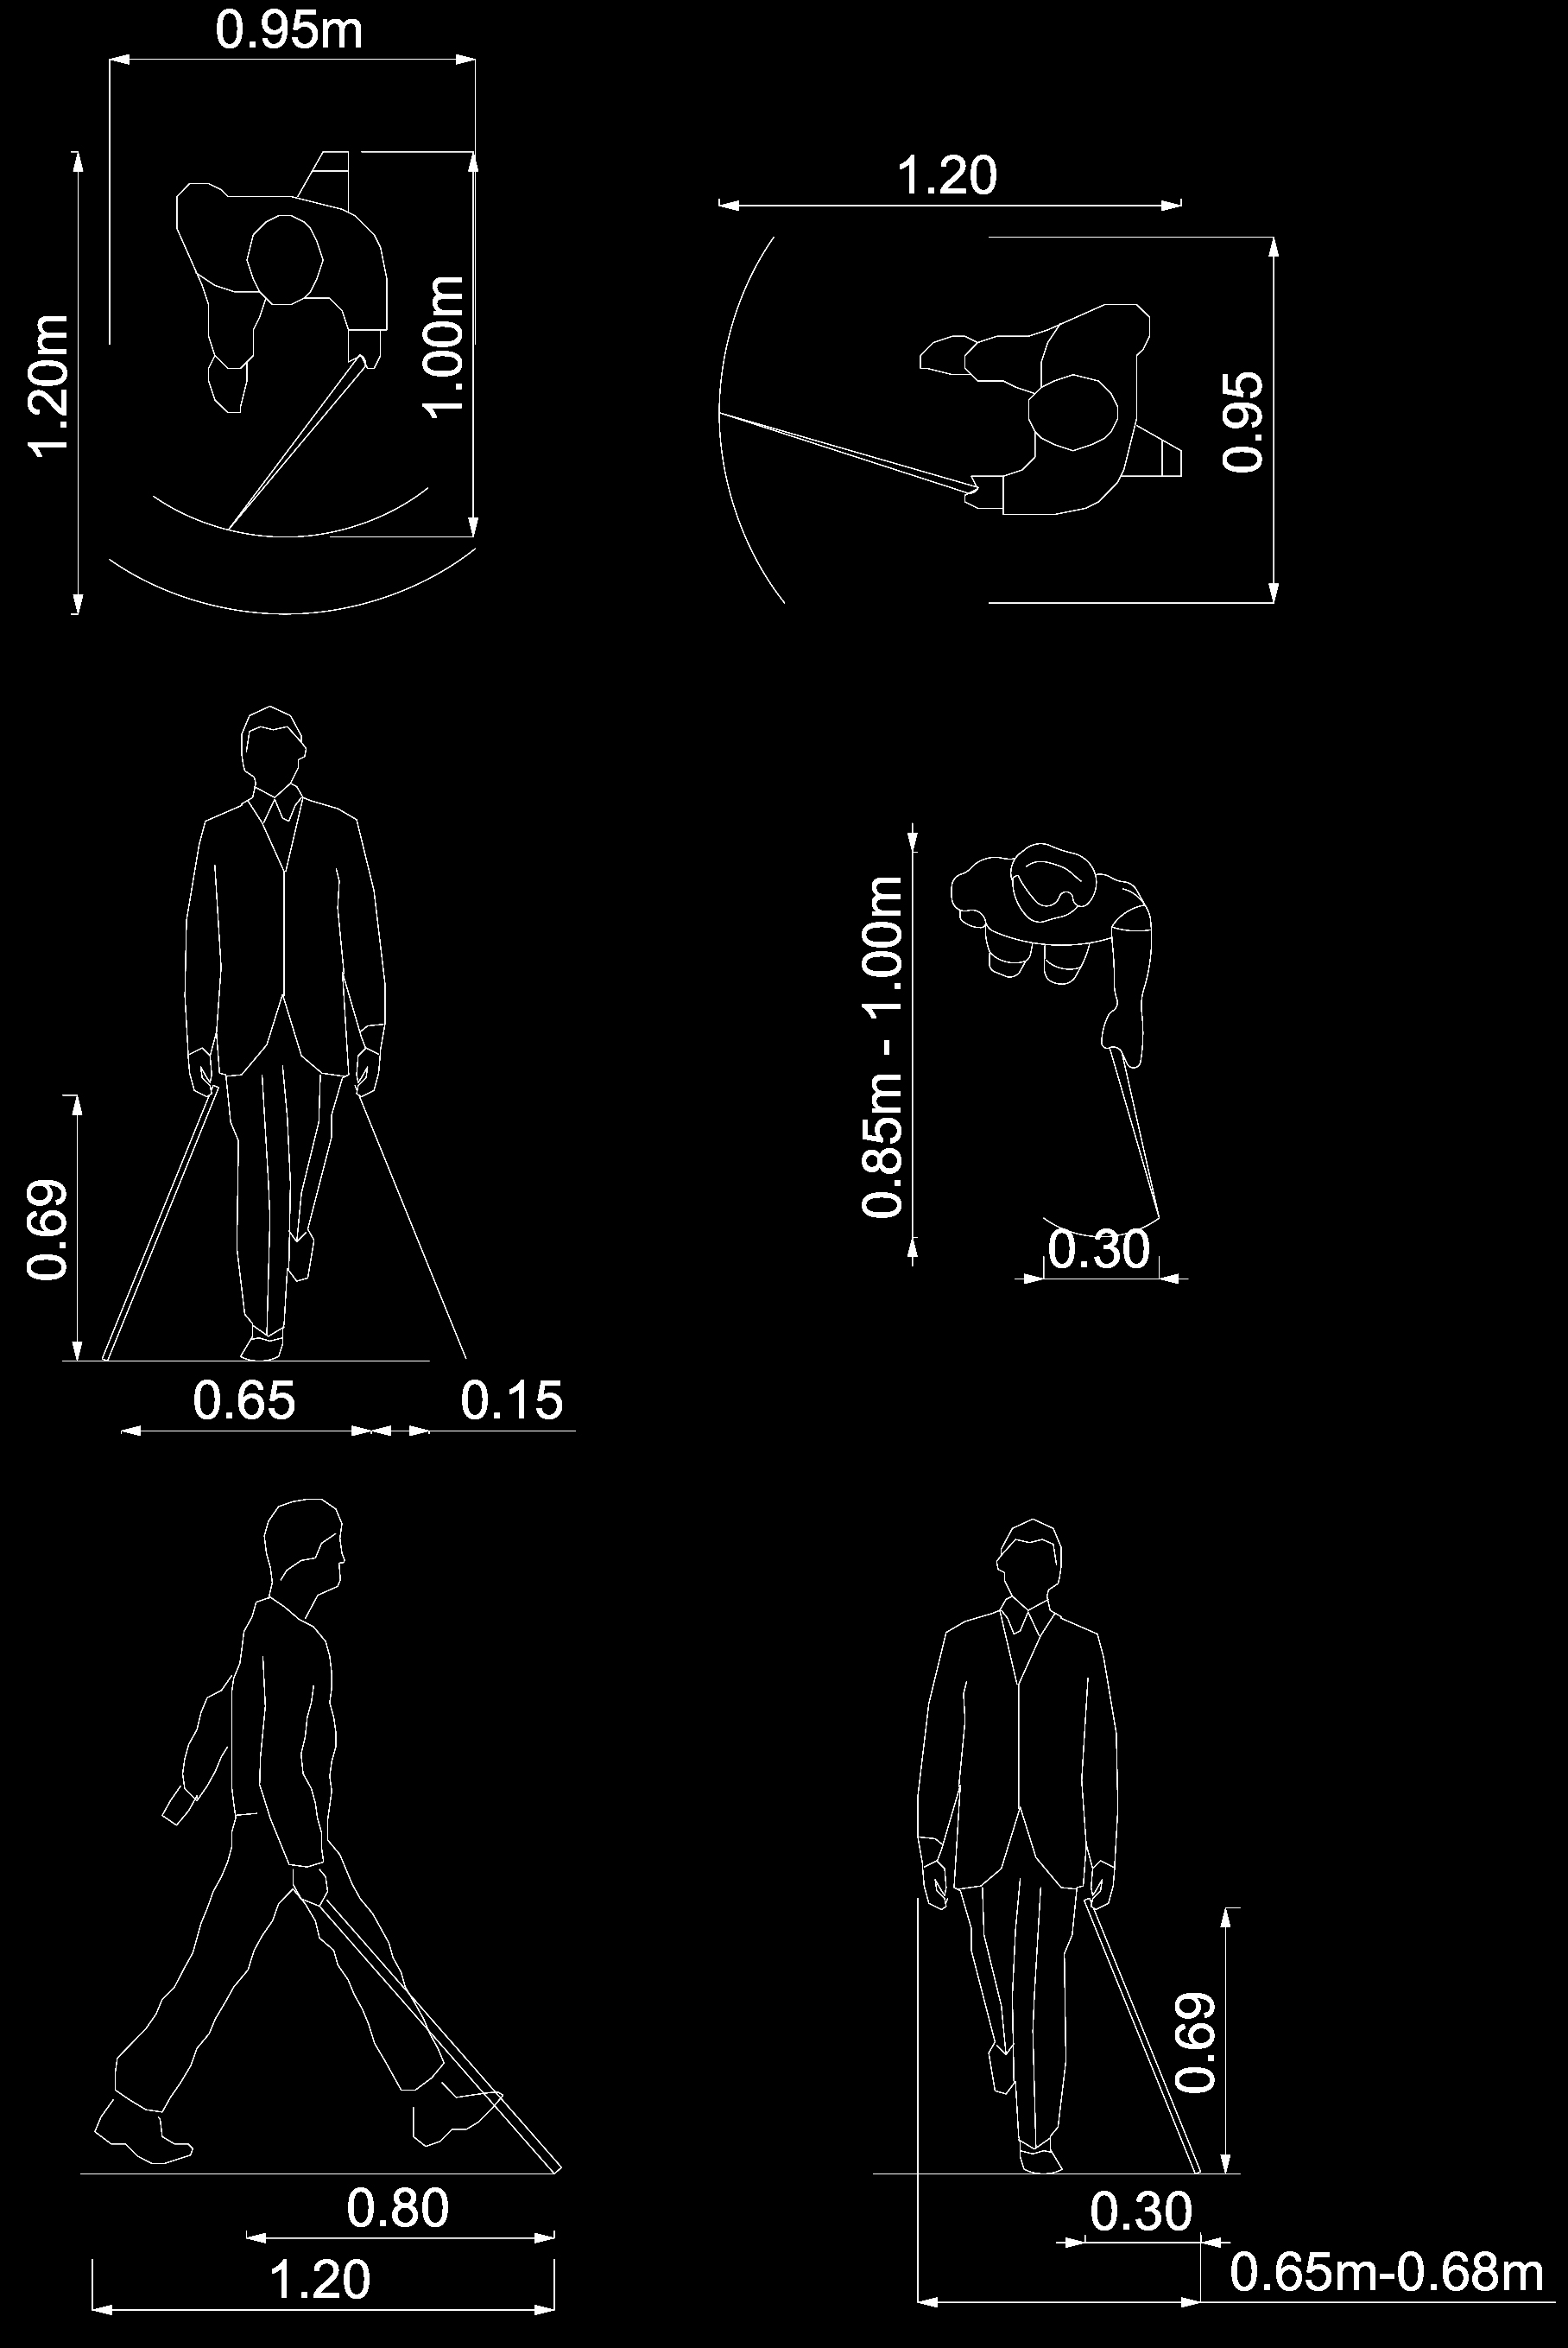
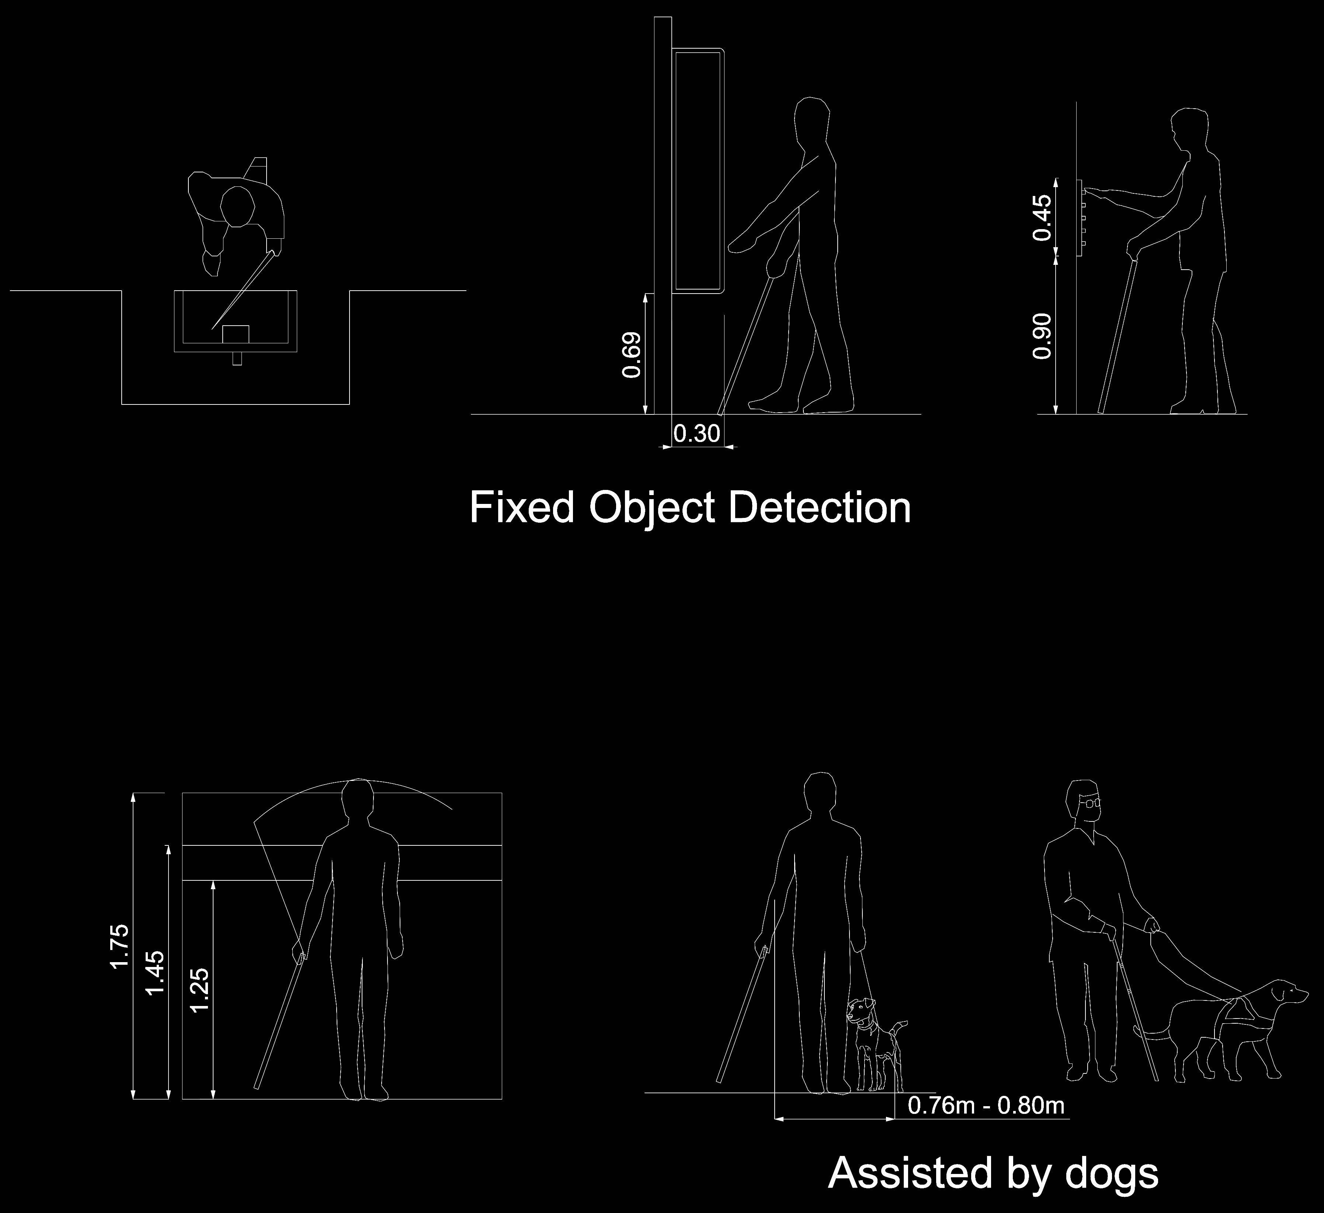
ANTHROPOMETRIC CONSIDERATIONS

Slide 13
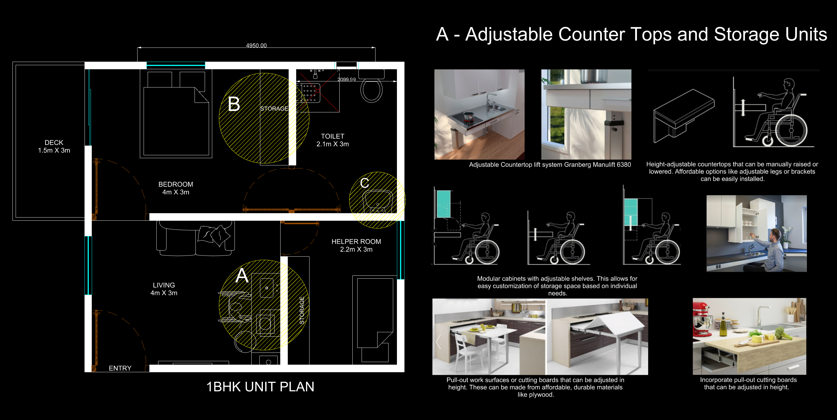

Slide 14
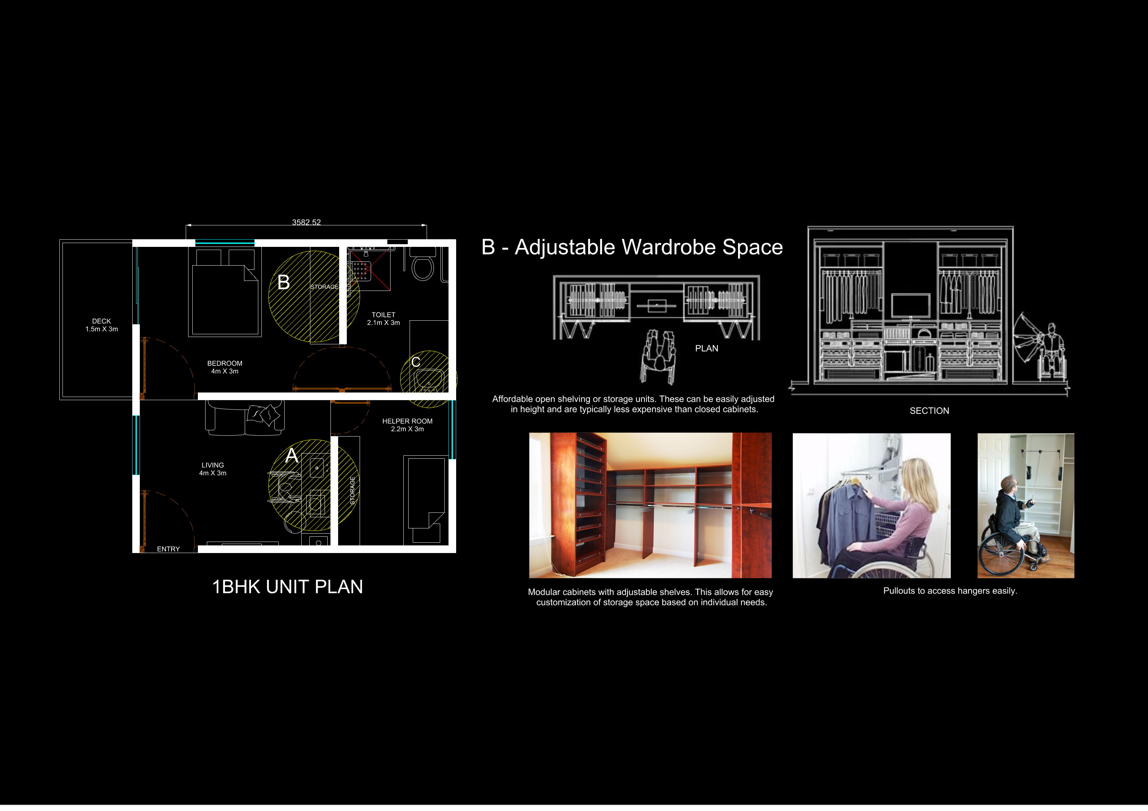
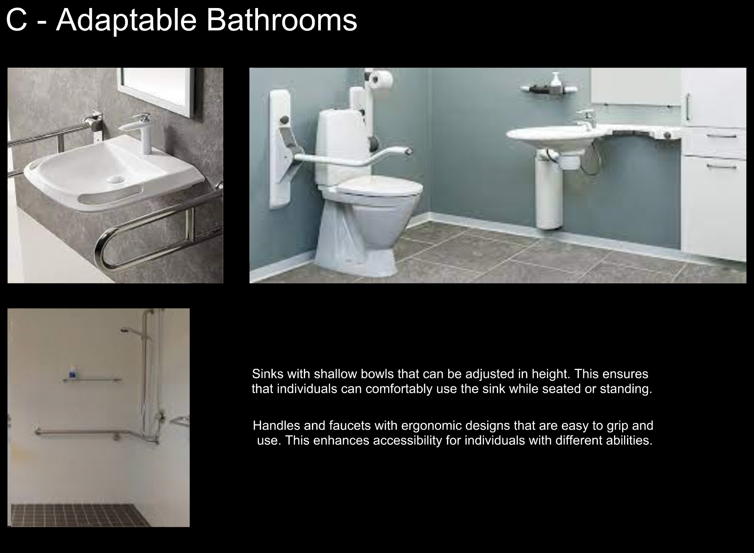

Slide 15
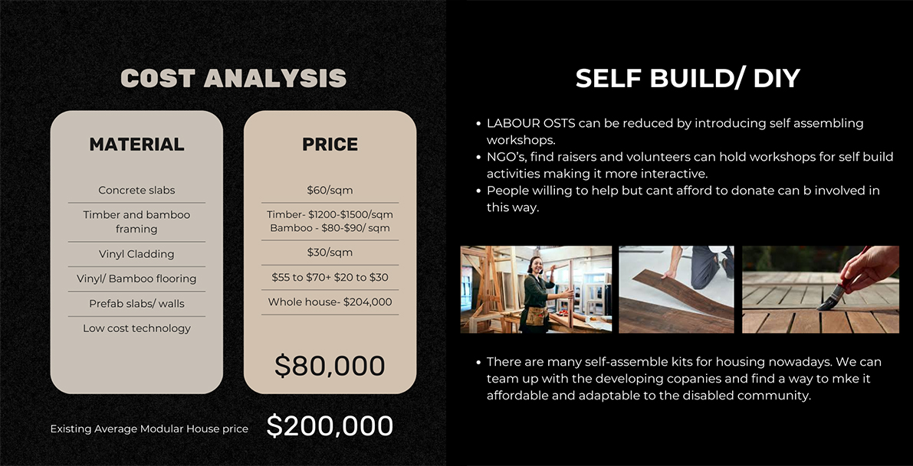

Slide 16
HOW IS THIS GOING TO BE FUNDED?
A combination of government grants, private investments, philanthropic foundations, and partnerships with developers.

