Slide 1
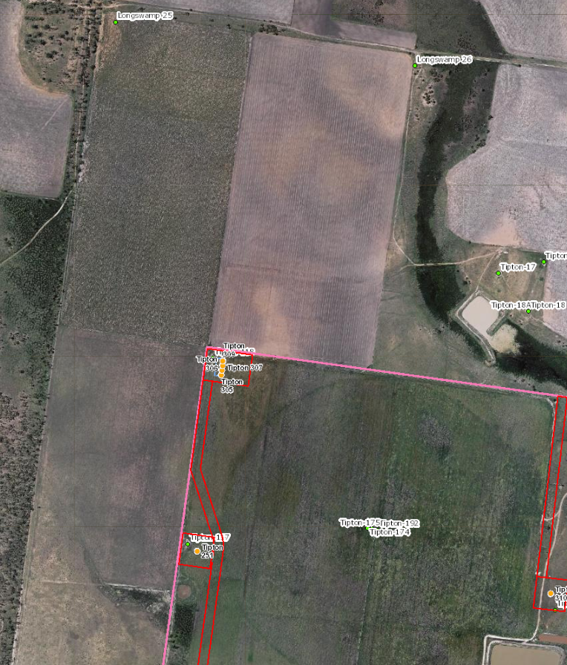
Wells - Tipton 305, 306, 307, 309
Wells Tipton 305, 306, 307, 309
Activity
  4 deviated wells on existing well pad
Current Land Use
  existing well pad Tipton 118
  Agricultural use is grazing land
  Neighbouring area is cropping (irrigation from centre pivot)
Disturbance
  Increase in size of existing well pad by 0.2ha
Mitigation to reduce impact on PALA
  Wells on existing well pad
  Well pad is located in corner of paddock outside of centre pivot area
  Use of Deviated Wells - 4 wells on existing well pad (with vertical well) to minimise surface disturbance
  Deviated subsurface locations are under cropped land with no disturbance in these paddocks
  Reduced gathering required
Gathering
  Wells use existing gathering and new pipes in same ROW
  subsurface well position

Slide 2
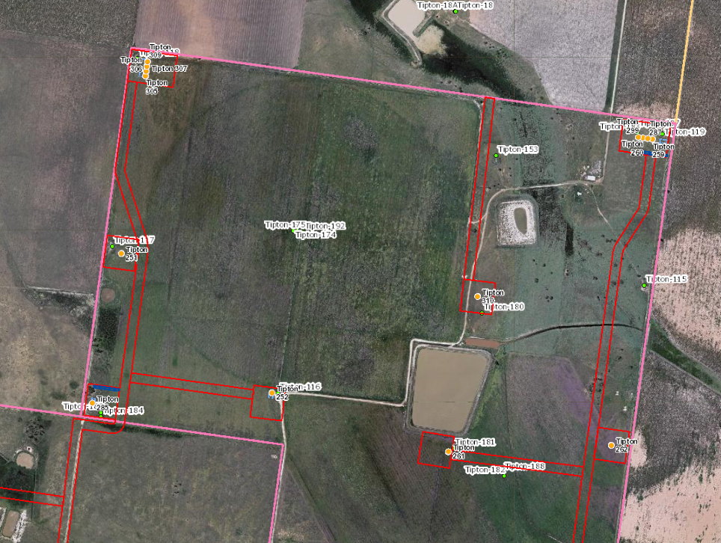
Wells Tipton 251, 252, 310, 285
Wells Tipton 251, 252, 310, 285
Activity
  4 vertical wells on 4 existing pads (twin wells)
Current Land Use
  existing well pads
  Current surrounding agricultural use is grazing land with cropping nearby
Disturbance
  Increase in size of existing well pads by 0.1ha each
Mitigation to reduce impact on PALA
  Wells on existing well pads
  Well pads are located on edge of paddock outside of centre pivot area that can be cropped
Gathering
  Wells use existing gathering and/or new pipes in same ROW

Slide 3
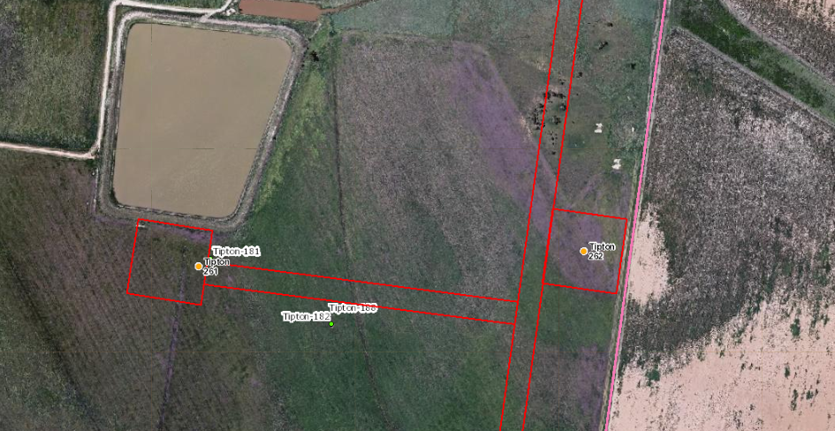
Wells Tipton 261, 262
Wells Tipton 261, 262
Activity
  2 vertical wells on 2 new well pads
Current Land Use
  Current surrounding agricultural use is currently grazing (has been cropped previously)
Disturbance
  Well pads area will be 0.1ha each post construction
Mitigation to reduce impact on PALA
  Well pads are located on edge of paddock to minimise area that will not be cropped (0.2ha)
Gathering
  Wells use existing gathering and/or new pipes in same ROW
  ROW rehabilitated to allow cropping post construction

Slide 4
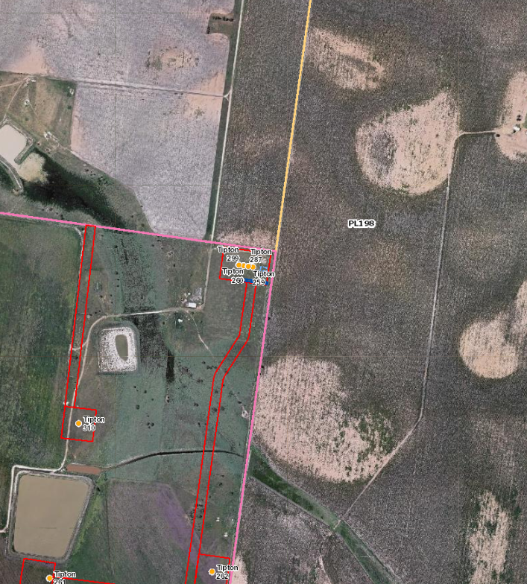
Wells - Tipton 259, 260, 287, 299
Wells Tipton 259, 260, 287, 299
Activity
  1 vertical and 3 deviated wells on an existing well pad
Current Land Use
  existing well pad
  Agricultural use is grazing land
  cultivation on neighbouring landholders area.
Disturbance
  Increase in size of existing well pad by 0.3ha
Mitigation to reduce impact on PALA
  Wells on existing well pad
  Well pad is located in corner of paddock
  Use of Deviated Wells – 3 wells on existing well pad (with vertical well) to minimise surface disturbance
  Subsurface locations are under cropped land with no disturbance in these paddocks
  Reduced gathering required
Gathering
  Wells use existing gathering and new pipelines in same ROW
  subsurface well position

Slide 5
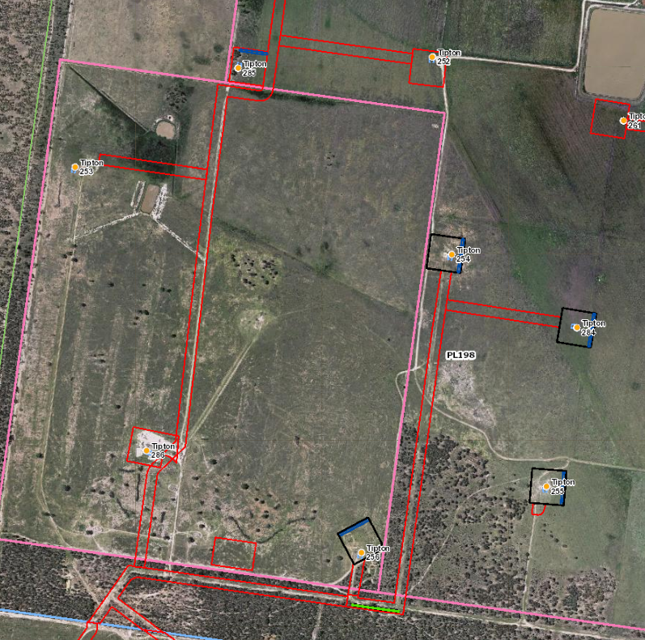
Wells Tipton 253, 254, 255, 256, 286
Wells Tipton 253, 254, 255, 256, 286
Activity
  5 vertical on 5 existing well pads
Current Land Use
  Current surrounding agricultural use is grazing land
Disturbance
  Well pads area will be 0.1ha each post construction
Mitigation to reduce impact on PALA
  Well pads are located on existing well pads
Gathering
  Wells use existing gathering and/or new pipes in same ROW

Slide 6
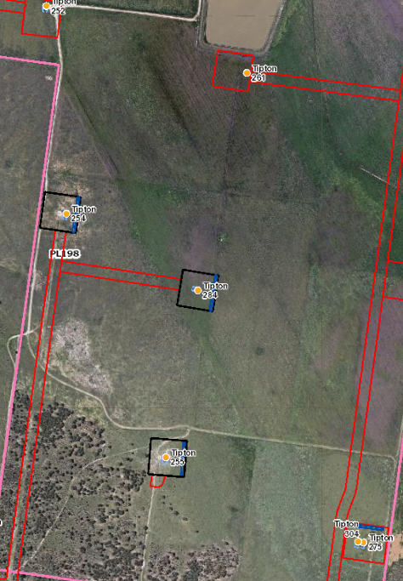
Wells Tipton 284
Wells Tipton 284
Activity
  1 vertical well on a new well pad
Current Land Use
  Current surrounding agricultural use is grazing land with cropping nearby
Disturbance
  Well pads area will be 0.1ha each post construction
Mitigation to reduce impact on PALA
  Well pads are located on edge of paddock outside of area that has been cropped
Gathering
  Wells use existing gathering and/or new pipes in same ROW

Slide 7
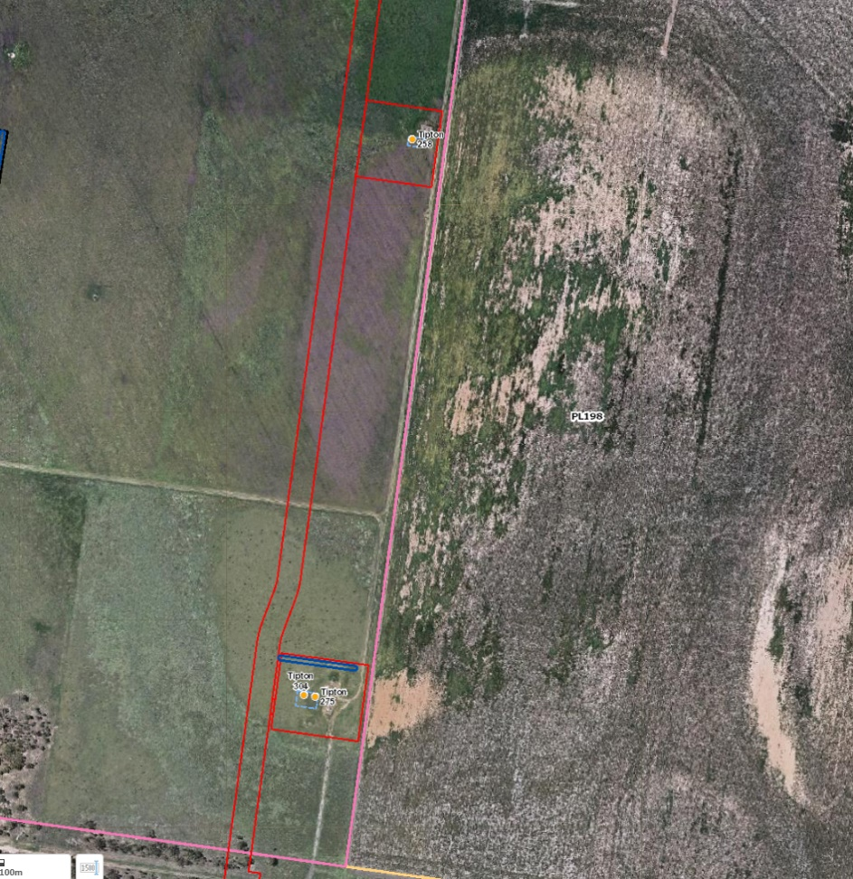
Wells - Tipton 258, 275, 304
Wells Tipton 258, 275, 304
Activity
  1 vertical and 2 deviated wells on two existing well pads
Current Land Use
  existing well pad
  Agricultural use is grazing land
  cultivation on neighbouring landholders area.
Disturbance
  Increase in size of existing well pad by 0.1 and 0.2 ha
Mitigation to reduce impact on PALA
  Wells on existing well pads
  Use of Deviated Wells – 1 wells on existing well pad (with vertical well) to minimise surface disturbance
  Subsurface locations are under cropped land with no disturbance in these paddocks
  Reduced gathering required
Gathering
  Wells use existing gathering and new pipelines in same ROW
  subsurface well position

