Slide 1
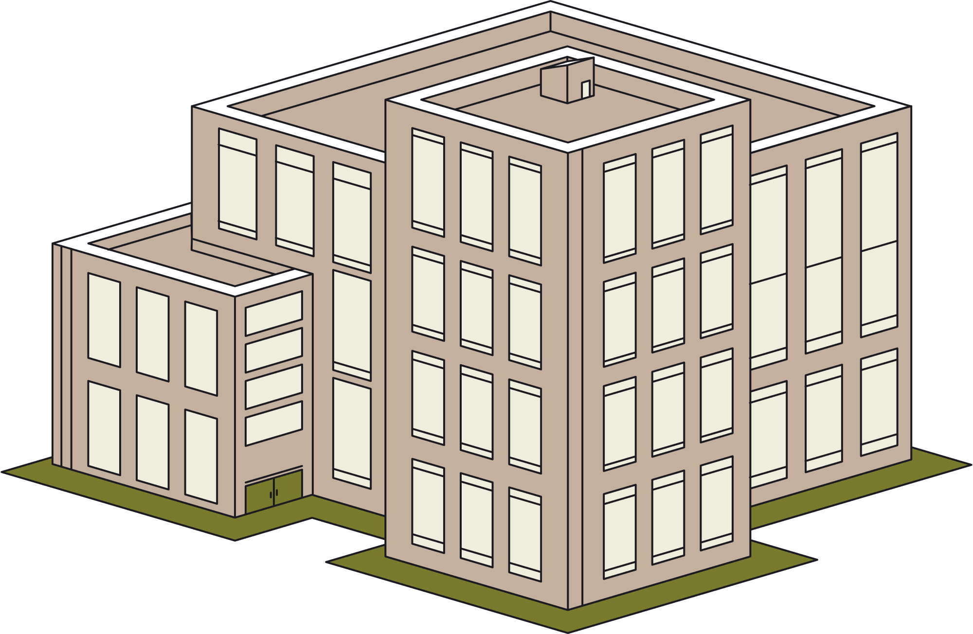
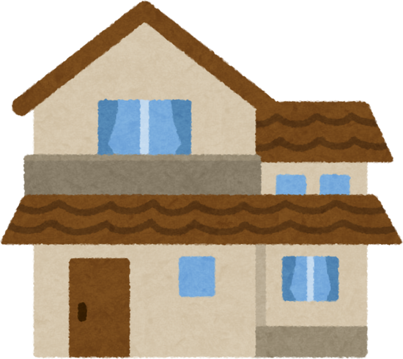



The QLD Housing Crisis
Let’s think outside the
B O X
Lauren Hall
UQ Student
Queensland Government Wicked Planning Problem

Slide 2






The
Context
Solutions to the Housing Crisis
150,000
QLD households faced insecurity in 2023
Many different disciplines to consider.
  Policy
  Economic
  Planning
Double the affordable housing stock
is needed to meet the demand.
Even in the planning discipline alone, there are too many possible solutions to count.
  Greenfield/brownfield development?
  Changing zoning restrictions?
  Encouraging medium density?
Homelessness has risen by
22% in the past 4 years
Lets think outside the box of typical development and consider the changing world we live (and plan) in.
Pawson, H et al.(2023).A blueprint to tackle Queensland’s housing crisis. Queensland Council of Social Service.
1
Notes:
Pawson, H et al.(2023).
A blueprint to tackle Queensland’s housing crisis. Queensland Council of Social Service.
150,000 households were facing housing insecurity
27,000 households on the social housing waiting lists
Homelessness risen by 22% in QLD compared to 8% nationally 2018-2022
Double the amount of affordable housing stock is needed over the next decade to keep up with demand
Greater QLD affordable housing % dropped 36% and 17% and Brisbane 19% to 10%
PROBS DONT NEED TO SAY ALL THAT

Slide 3
Times are
Changing
COVID-19, and society’s response to it, has changed the way we work and learn.
  Office occupancy rates in Australia have stayed below pre-COVID levels
  Many universities have continued to provide flexible learning options
Likewise, the digital age has resulted in a shift from physical to online shopping.
  There is less need for large shopping malls (and large car parks)
  In the U.S, chain retailers are closing physical stores in favour of improving delivery services
Working from home and online shopping is here to stay. This has led to an increase in vacant office, retail, and education spaces.
2
Notes:
not for this slide but in the future
Solutions to the housing crisis focus on the past - outdated zoning regulations, historical urban sprawl.
This is a solution that looks to the future of human development and mobility, rather than the past.

Slide 4
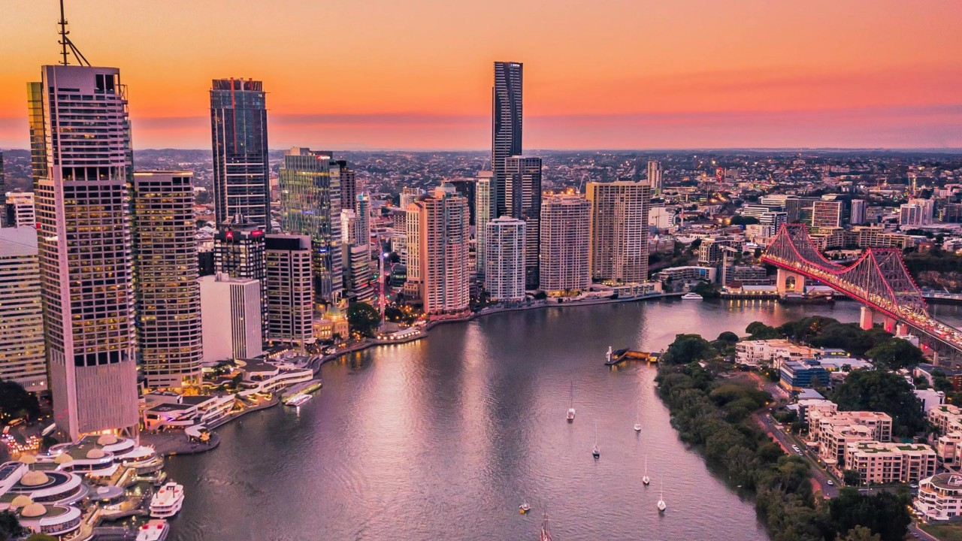
So...
How can we plan for a lack of houses but an abundance of commercial space?
Vacant office or retail buildings can be repurposed into residential developments. This adaptive reuse of existing infrastructure can help deliver affordable housing in well-located regions, while improving the sustainability of the construction sector.
3

Slide 5
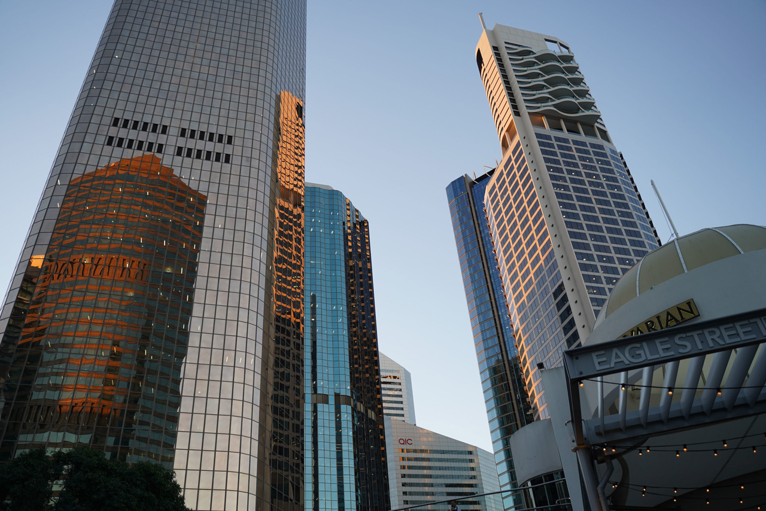
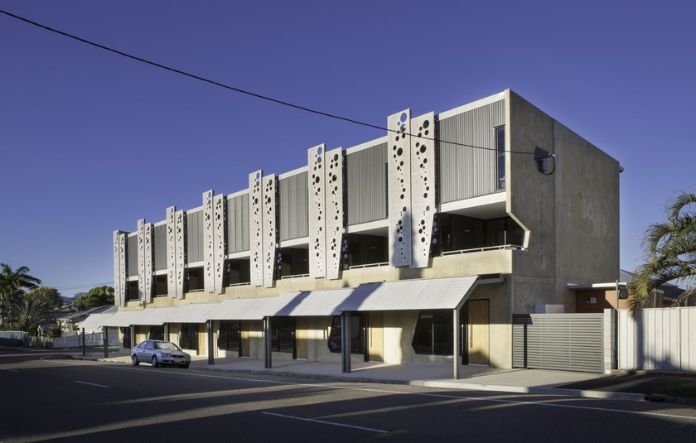
Defining
Adaptive reuse of commercial space
Current literature has focused on:
  High density
  Office buildings
  Luxury residential conversions
OR?
The scope can be widened to include:
  Low and medium densities
  Retail and educational land uses
  Affordable housing
4
Notes:
This is not an entirely new concept, but it is underexplored. Current literature focuses primarily on high-density office buildings. However, I argue that the scope should be wider, and there are benefits in low/medium density renewal. NOTE THAT WE'RE JUST SAYING COMMERCIAL
Affordable is what we need due to housing crisis.
Here's an example of a

Slide 6

Opportunities with
the reuse of commercial space
Opportunity 1
Opportunity 2
Pre-existing necessities
  Transport
  Jobs
  Community facilities
Pre-existing utilities
  Water/electricity
  Fire alarms
  Lifts
Sustainability
  Less construction / materials / transport emissions
  No deforestation or demolition needed
  Estimated 1/2 of upfront carbon emissions compared to business-as-usual
5
Notes:
Two main benefits
Unlike greenfield development, this is near pre-existing necessities
This is similar to brownfield. But also utilities there already (note may need reworking). The other difference lies in the second benefit - sustainability

Slide 7
Challenges with
the reuse of commercial space
Challenge 1
Challenge 2
Challenge 3
Layout limitations
  Utilities (i.e. fire alarms, water pipes) would need reworking
  Floor plan needs to consider windows
Regulations
  Zoning may restrict residential use
  Little precedent to follow
Aging buildings
  Older buildings may not meet safety or sustainability standards for residential use
6
Notes:
will have to rebut this - show how example chose certain ones

Slide 8
A relevant
Report
“Radical Reuse - From Office to Home” (Hassel, 2023)
Location: Melbourne CBD
Aim: To determine the feasibility of adaptive re-use of office buildings, as well as identifying potential buildings to be reused.
Criteria:
  Built before 1990
    More likely to be vacant and in greater need of renewal
  10+ storeys high
    Structural capacity for additional level
    Sufficient scale to provide greatest benefit
  ~24m width
    Ensures access to natural light
Hassel (2023). Radical Reuse - From Office to Home.
7
Notes:
However, these challenges can be overcome, as shown by this research in study in Melbourne
Source: Hassel (2023). Radical Reuse - From Office to Home.

Slide 9
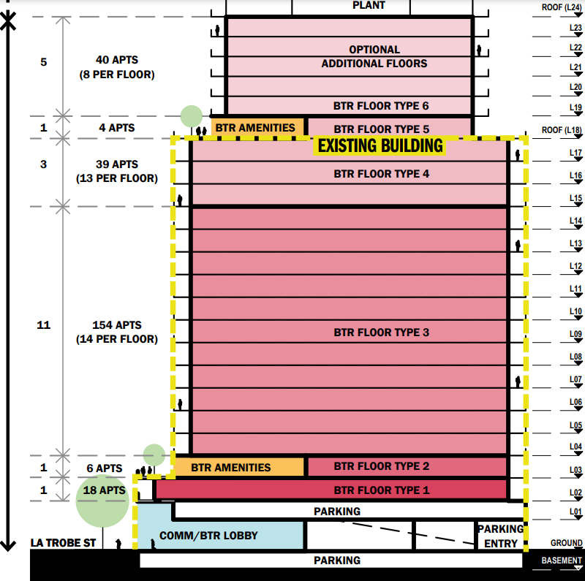
A relevant
Report Cont.
Findings:
    86 buildings in the CBD showed potential for reuse
    Even considering half of these options (43 buildings), an estimated 10,000-12,000 dwellings could be created
    Compared to a new development, only an estimated half of the carbon emissions would be produced
    EG: 469 La Trobe Street could provide 217 dwellings using the existing footprint or 261 dwellings if constructing additional floors.
8

Slide 10
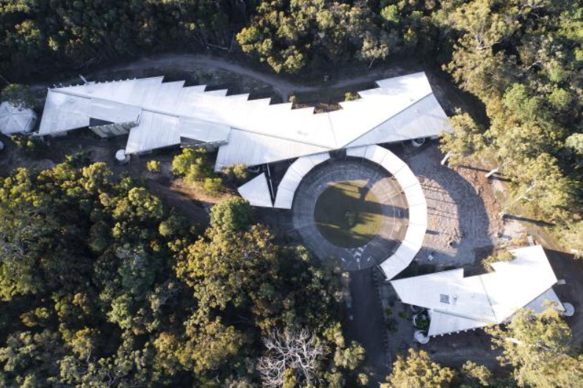

A local
Example
The Tewantin TAFE
Constructed in 2004
Opened in 2006
Closed in 2014
EOIs submitted 2021 but no update
In the ten years since closure, it has been extensively vandalised despite little damage to the building itself
Maccoll, M (2023). Tafe wears as negotiation continues. Noosa Today
9
Notes:
Source: Maccoll (2023). Tafe wears as negotiation continues. Noosa Today
As said prior, there is a focus on buildings such as this. However, here's a local example of low-density that could also be reused. (this has annoyed me my whole life and is one of the inspirations for this topic). I used to live about 3 minutes away.
There's endless reasons as to why it's been closed for 10 years, and is a difficult site to work with due to multiple overlapping factors (bushfire, koala habitat, negotiation between Council and State).

Slide 11
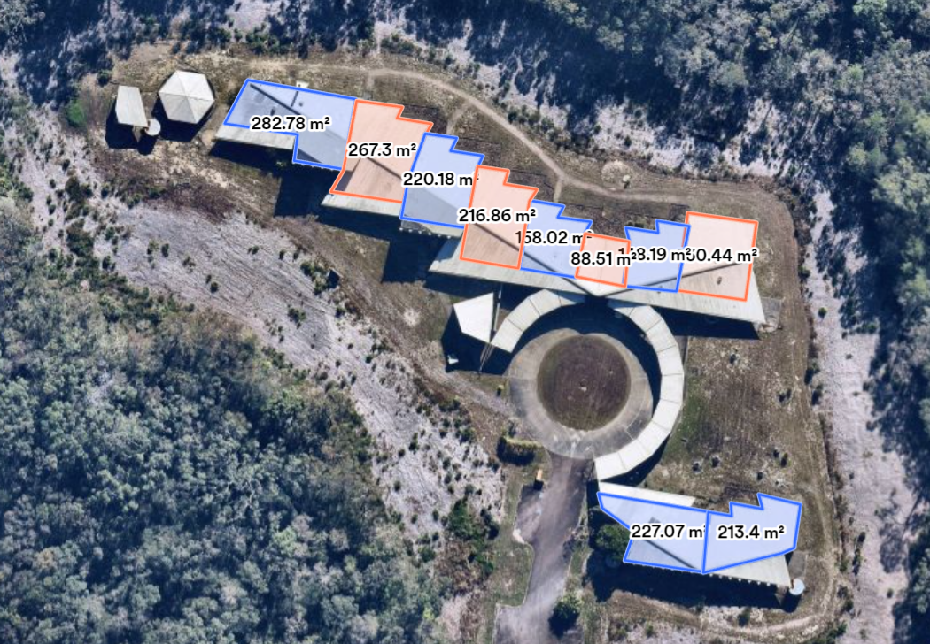
A local
Example Cont.
Affordable Housing
10 dwellings of differing household sizes
Space for parking, landscaping, even community uses (i.e. working shed to the west of the lot).
Located close to the centre of the town, with access to shops, services, schools, and leisure
10
Notes:
However, there has been residential precincts built in similarly zoning nearby, so I will use it as an example of adaptive reuse that does not rely on high-density office space.

Slide 12




Why
Queensland?
With a scope that includes low-medium densities, adaptive reuse can be considered throughout the state, rather than just in a city’s CBD
There are already multiple housing affordability policies targeted to many regions throughout Queensland - there is a legislative precedent for residential development that prioritises affordability
Due to the Brisbane 2032 Olympics taking place in venues across Queensland, developers will be considering innovative projects in both urban and rural areas
11

Slide 13



Why
Planning?
As planners, our priority is to creating sustainable and liveable communities. Adaptive reuse of commercial space is a practical method to provide affordable housing in areas that are able to accommodate the population, while limiting the construction sector’s emissions.
What can be done?
Ease zoning
restrictions
Start
small
Offer
incentives
12
Notes:
zoning for better adaptive re-use, start small (prior example), offering incentives for developers (tax depreciation). would work under mixed-use as long as we make sure its affordable!!!!!!!

Slide 14
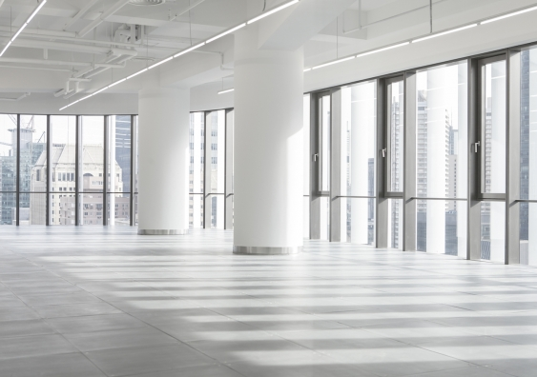
Final words
Adaptive re-use is a solution to the housing crises that looks to the future of human development and sustainability.
This is an area of study that needs far more attention, and a much wider scope - we shouldn't only consider high-density office buildings and instead look towards how adaptive reuse could work in our suburbs and regions, and from different blueprints.
Thank you.
13
Notes:
Solutions to the housing crisis focus on the past - outdated zoning regulations, historical urban sprawl.
This is a solution that looks to the future of human development and mobility, rather than the past.

