Slide 1


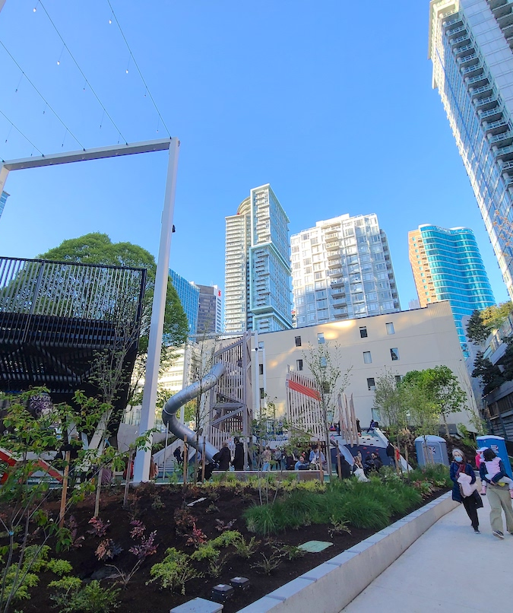

Designing Density for Families
Tom Kennedy – University of Queensland

Slide 2
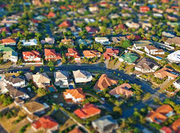
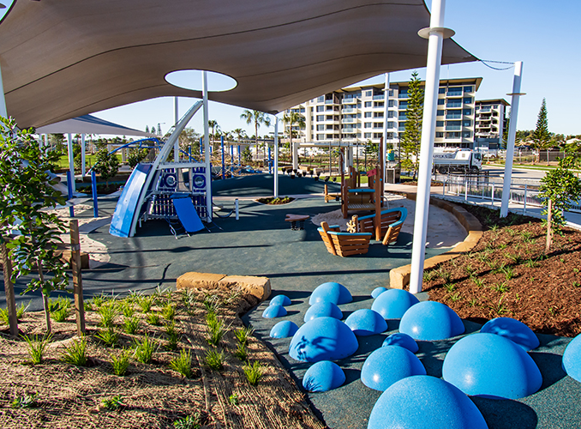
Re-casting the Australian Dream
z

Slide 3
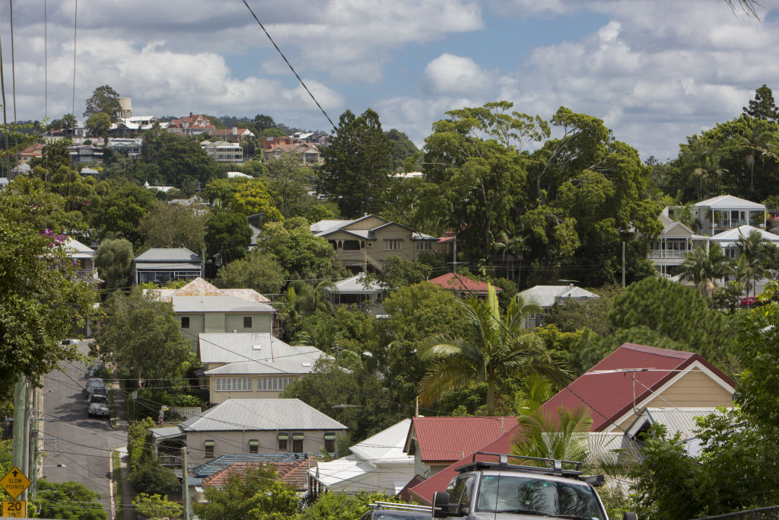
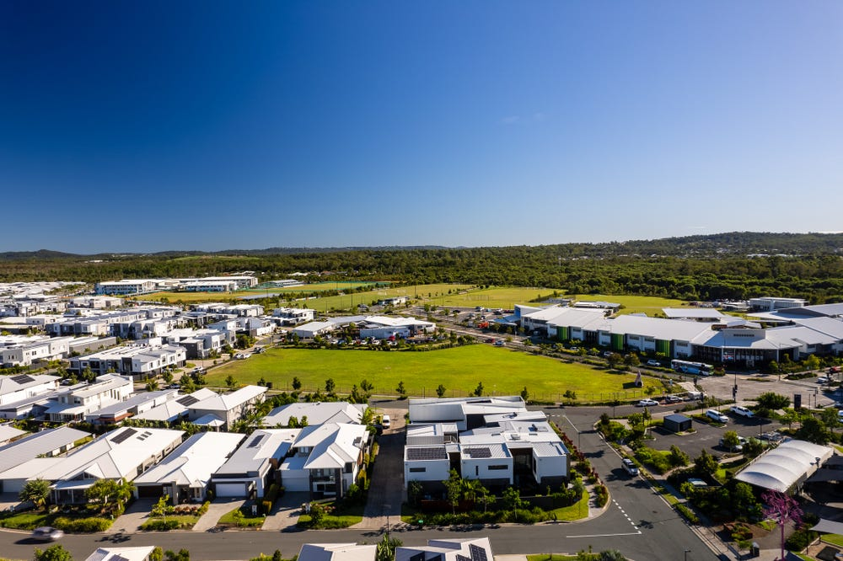
Current Situation
z
Preferred housing choice of families – detached home in established suburbs
25% of the population would actively prefer to reside in greenfield areas
Sentiment of apartments as a stepping stone

Slide 4
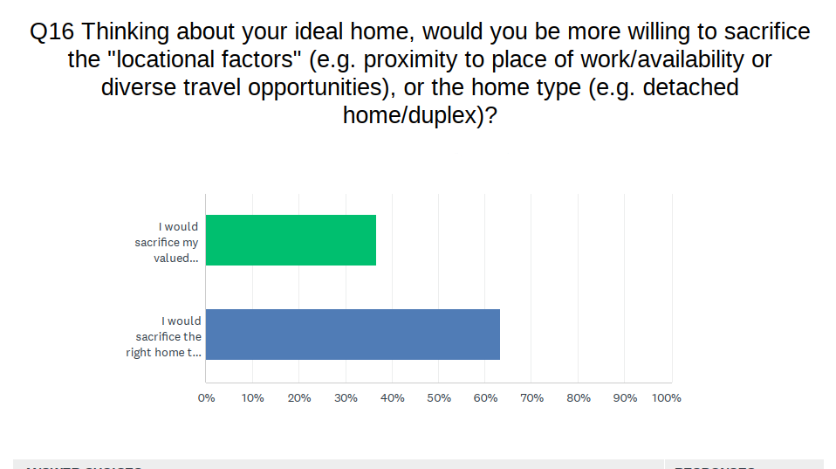
Shifting Sentiment
z
63% of young people willing to sacrifice type for location
Established suburbs present a desirable locational proposition:
  Jobs
  Education
  Infrastructure
  Housing diversity

Slide 5
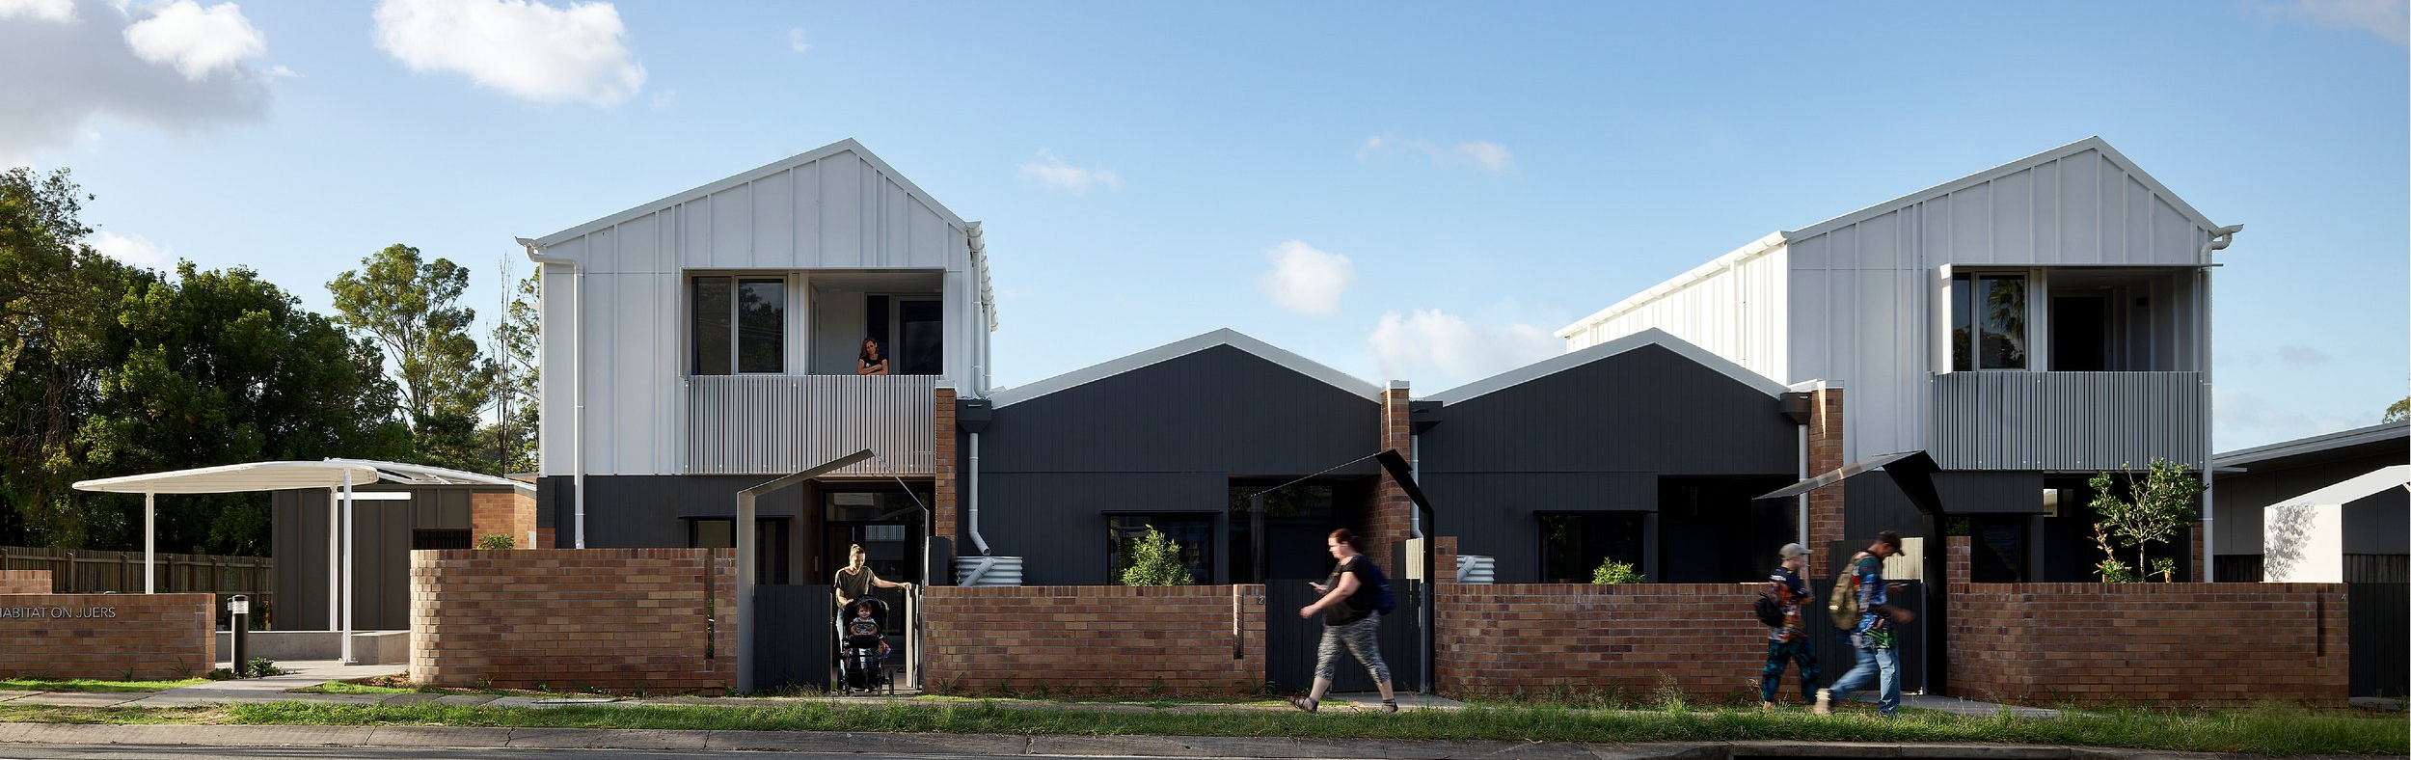
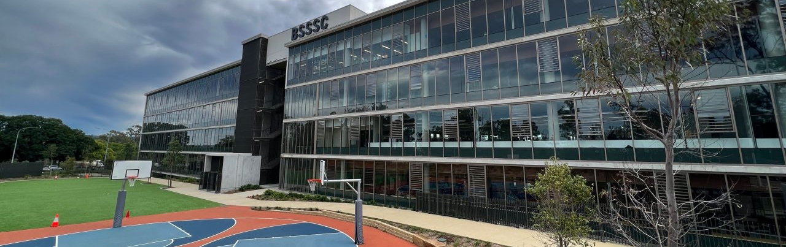
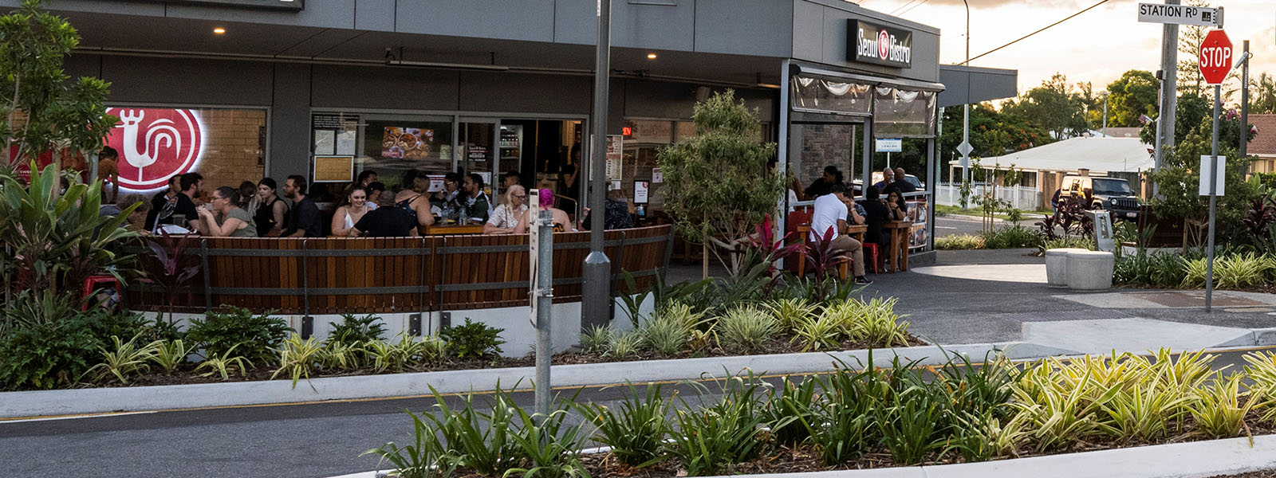
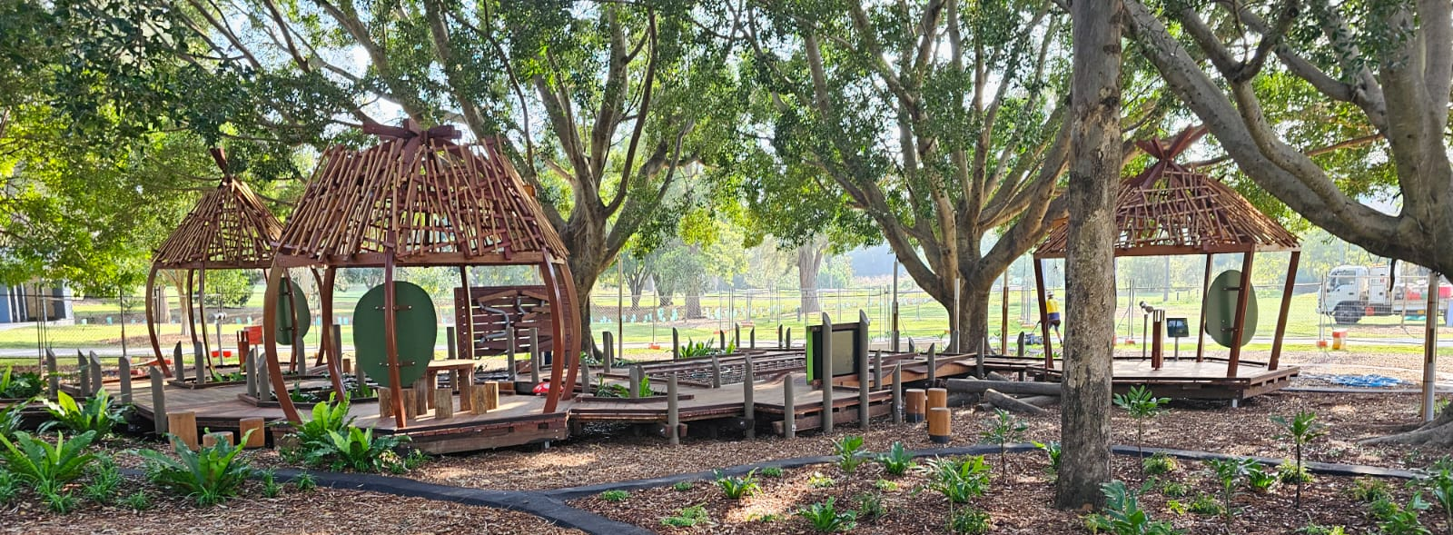
Principles for Family-Friendly Communities
Housing Choice
Access to Education
Walkability and Convenience
Recreation

Slide 6
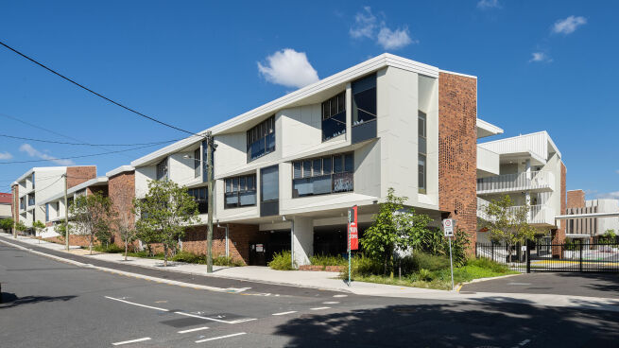
Current Challenges to Designing Density for Families
z
The School Catchment Effect
Supporting land-uses and infrastructure
Design of Built Form and Public Realm

Slide 7
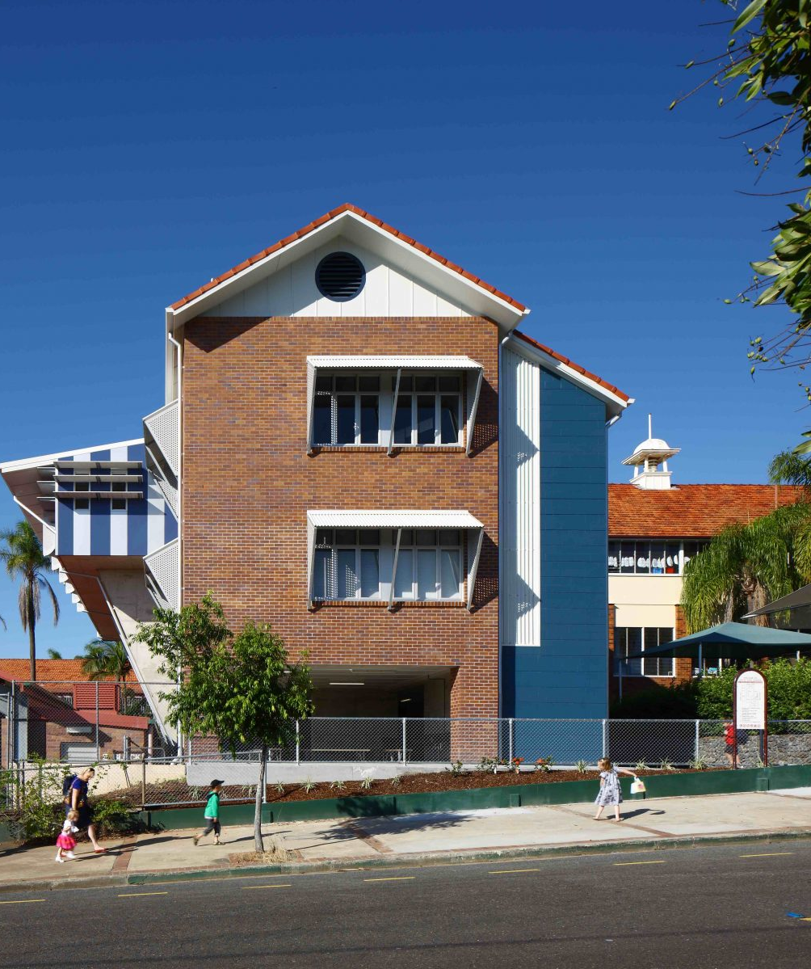
The School Catchment Effect
z
Willingness to pay to access school catchments placing pressure on prices
Risk of pricing out low-to-moderate income households, including teachers

Slide 8
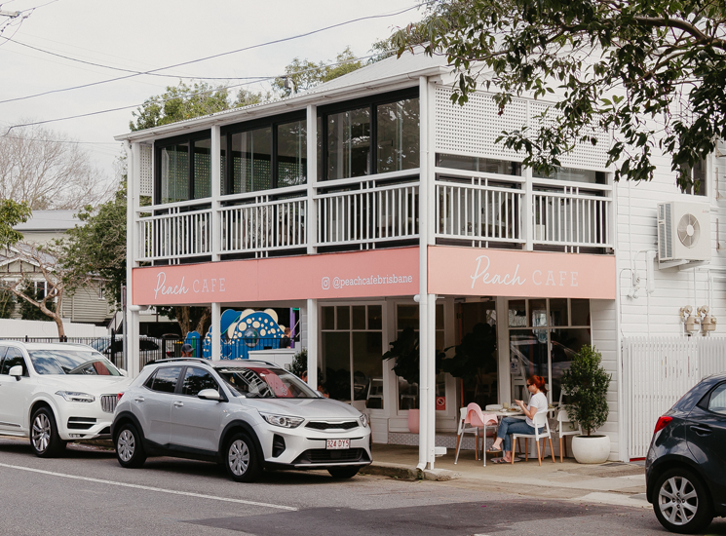
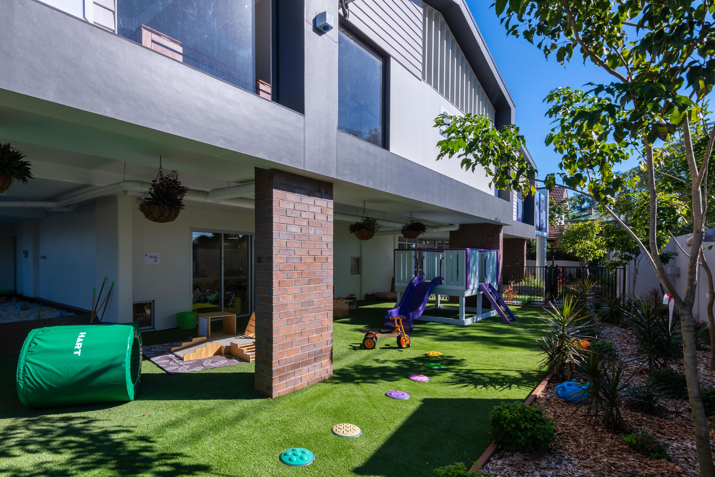
Supporting land-uses and infrastructure
z
Viable 20-minute neighbourhoods reliant on housing density (min. 25dw/ha)
Difficulty in retrofitting established suburbs due to planning risk

Slide 9
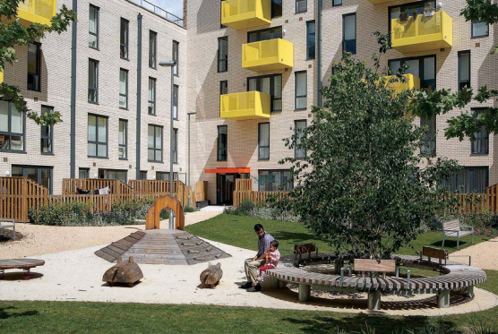
Lack of family friendly design
z
The lack of consideration for families residing in dense communities has resulted in:
Lack of suitably sized and affordable apartments
Lack of communal play spaces
Lack of indoor and outdoor storage
Insufficient soundproofing

Slide 10
Solutions
z
Planning reforms to deliver greater housing choice in school catchments
De-risking household-related amenities
Child-friendly design

Slide 11
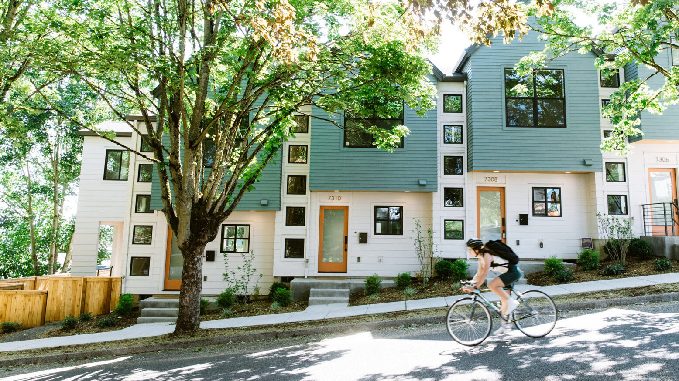
Planning reforms to deliver greater housing choice in school catchments
z
Permissive planning settings to enable gentle density in catchments
Delivers equality of access to education
Facilitates housing affordable to teachers

Slide 12
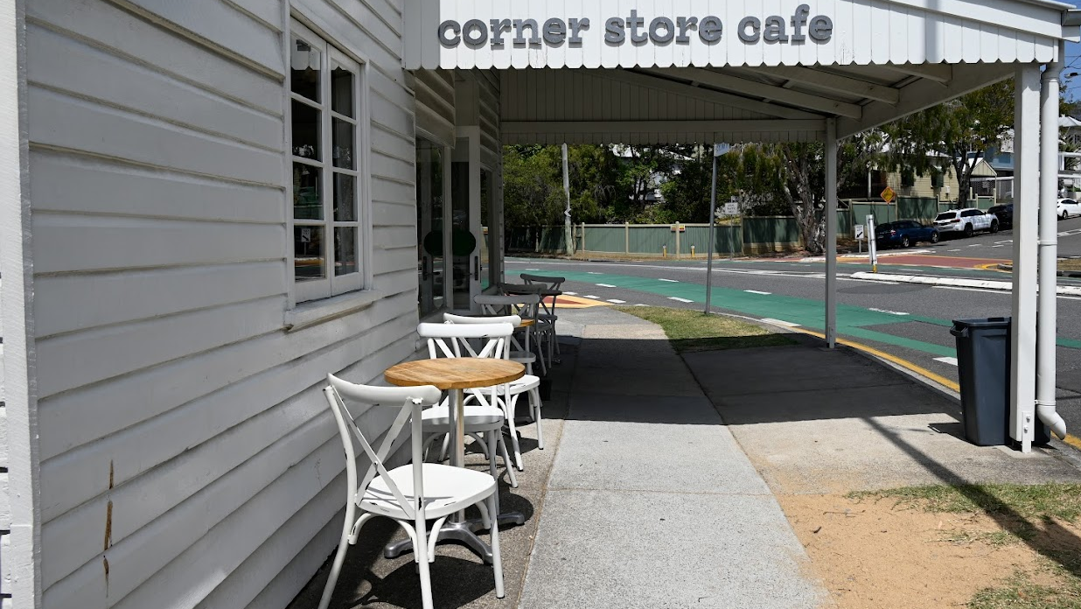
De-risking the establishment of household-related amenities
z
Establish a household-related amenities activity group
  Food and drink outlet
  Childcare services
  Educational establishment
  Health care services
  Community use
  Shop
Lower the level of assessment to code assessable, responsive to scale

Slide 13
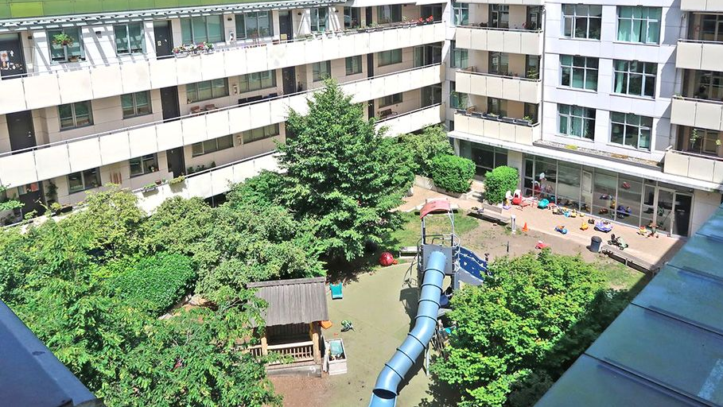
Child-friendly design principles
z
Establishing child-friendly design guidelines, relating to and incentivising:
Play spaces in communal space
Suitable apartment layouts
Sufficient indoor and outdoor storage

Slide 14
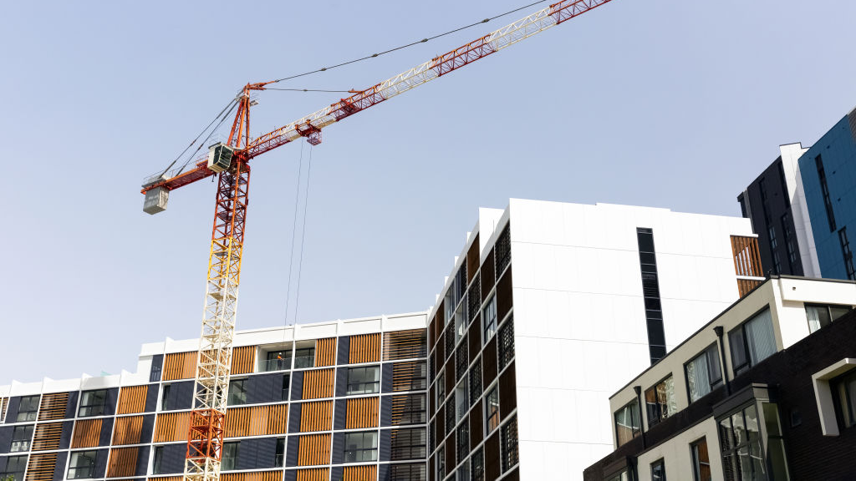
Implementation
z
Introduce school catchments within the ‘High Amenity Areas’ framework under ShapingSEQ 2023
Whole-of-government state interest review for streamlined planning scheme amendments, including with Department of Education for catchment alignment
Develop a Child Friendly Design Guide for best practice and incentives

Slide 15
References
Brennan, M., Reed, P., & Sturtevant, L.A. (2014). The Impacts of Affordable Housing on Education: A Research Summary. Center for Housing Policy. https://nhc.org/wp-content/uploads/2017/03/The-Impacts-of-Affordable-Housing-on-Education-1.pdf
Department of Environment, Land, Water and Planning. (2019). 20-Minute Neighbourhoods – Creating a more liveable Melbourne. The State of Victoria. https://www.planning.vic.gov.au/__data/assets/pdf_file/0022/653125/Creating-a-more-liveable-Melbourne.pdf
Jafari, A., Singh, D., & Giles-Corti, B. (2023). Residential density and 20-minute neighbourhoods: A multi-neighbourhood destination location optimisation approach. Health & Place, 83. https://doi.org/10.1016/j.healthplace.2023.103070
Krysiak, N. (2018). Design and Planning Policy for Family-Friendly Apartment Living. Policy Futures. https://policy-futures.centre.uq.edu.au/files/7682/PolicyFutures2021_Krysiak.pdf
Miller, L.J. (1995). Family Togetherness and the Suburban Ideal. Sociological Forum, 10(3), 393-418. https://www.jstor.org/stable/684782
One Final Effort. (n.d.). Auckland. https://onefinaleffort.com/auckland
Planning Institute of Australia. (2007). Child Friendly Communities. National Position Statement, no. 9. https://www.planning.org.au/documents/item/121
Rajapaska, D., Gono, M., Wilson, C., Managi, S., Lee, B., & Hoang, V. (2020). The demand for education: The impacts of good schools on property values in Brisbane, Australia. Land Use Policy, 97. https://doi.org/10.1016/j.landusepol.2020.104748
Raynor, K. (2018). ‘Children belong in the suburbs’: with more families in apartments, such attitudes are changing. The Conversation. https://theconversation.com/children-belong-in-the-suburbs-with-more-families-in-apartments-such-attitudes-are-changing-93742
Volders, S., & Andrews, F. (2018). Designing high density, inner city, residential developments for families with young children: A review of evidence for best practice. Proceedings of the State of Australian Cities Conference 2017. Adelaide.

