Slide 1

QUEENSLAND'S HOUSING MISMATCH: A GROWING CRISIS
DATE
Eli J. Rifai
11/10/2024
ONE SIZE DOES NOT FIT ALL
Our Shortage of Smaller Homes
THE UNIVERSITY OF QUEENSLAND
PRODUCED FOR
3rd Year
Bachelor of Regional & Town Planning Student
Queensland Government Planning Award Wicked Planning Problem

Slide 2
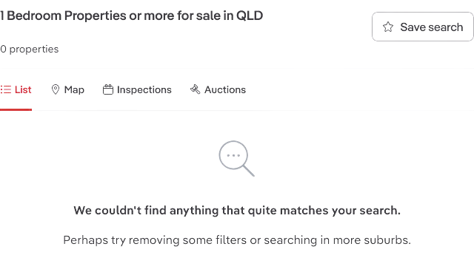

Slide 3

Median Rents, QLD
Dwelling Type | Number of Bedrooms | Rent (June 2024) | Rent per Bedroom
Flat | 1 | $450 | $450.00
 | 2 | $580 | $290.00
 | 3 | $600 | $200.00
House | 2 | $460 | $230.00
 | 3 | $555 | $185.00
 | 4 | $650 | $162.50
Townhouse | 2 | $530 | $265.00
 | 3 | $630 | $210.00
WHAT IS THE PROBLEM?
[1]

Slide 4


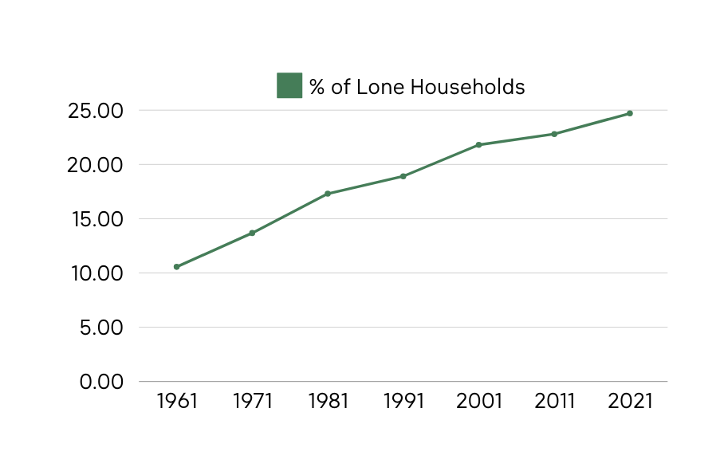
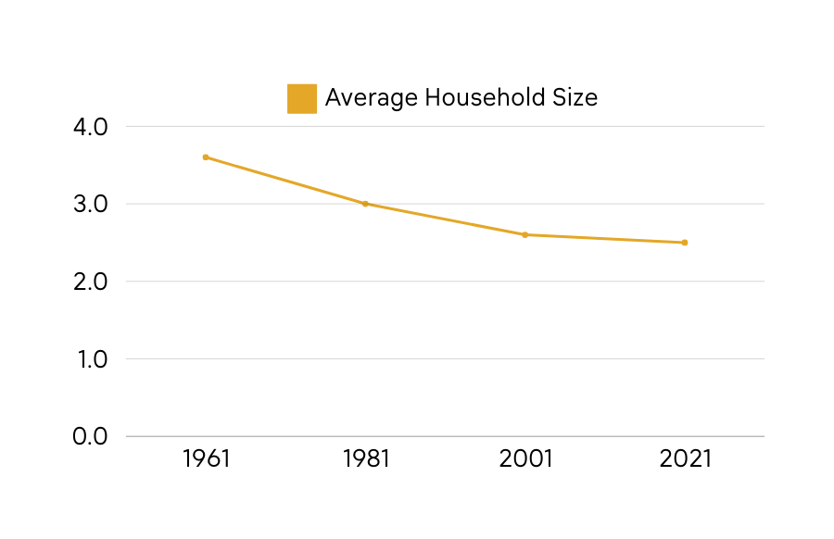
THE
DEMOGRAPHIC SHIFT
  Household size decrease: 3.6 (1961) → 2.5 (2021)
  A shift to starting families and marriage later in life
  Growing and longer living senior population
[2] [3]

Slide 5


Suburb | % of dwellings with 4 or more bedrooms | Decade Developed
Springfield Lakes | 87 | 2010s
Pallara | 84 | 2010s
Rochedale | 83 | 2000-2010s
North Lakes | 81 | 2000s
Flagstone | 80 | 2010-2020s
  In new major growth areas, over 80% of dwellings are being built with 4+ bedrooms
  State average for 4+ bedroom dwellings: 38.03%
  Queensland homes are the largest in the world by floor are
  Over 75% of Queensland dwellings have one or more bedrooms vacant
New Builds
THE SHIFT
[4] [5]

Slide 6
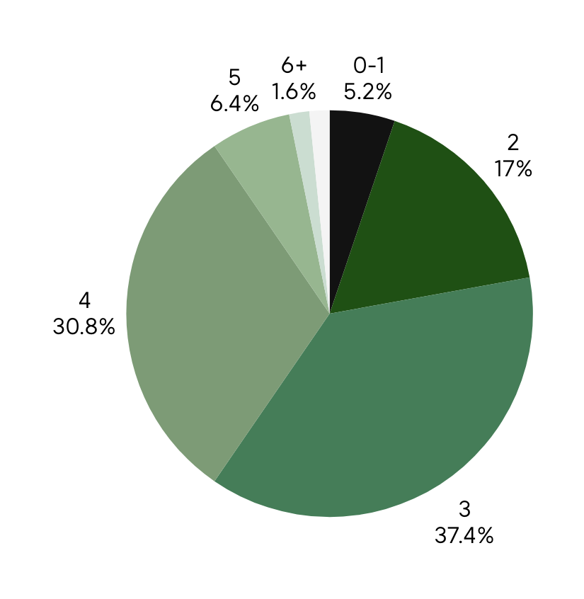
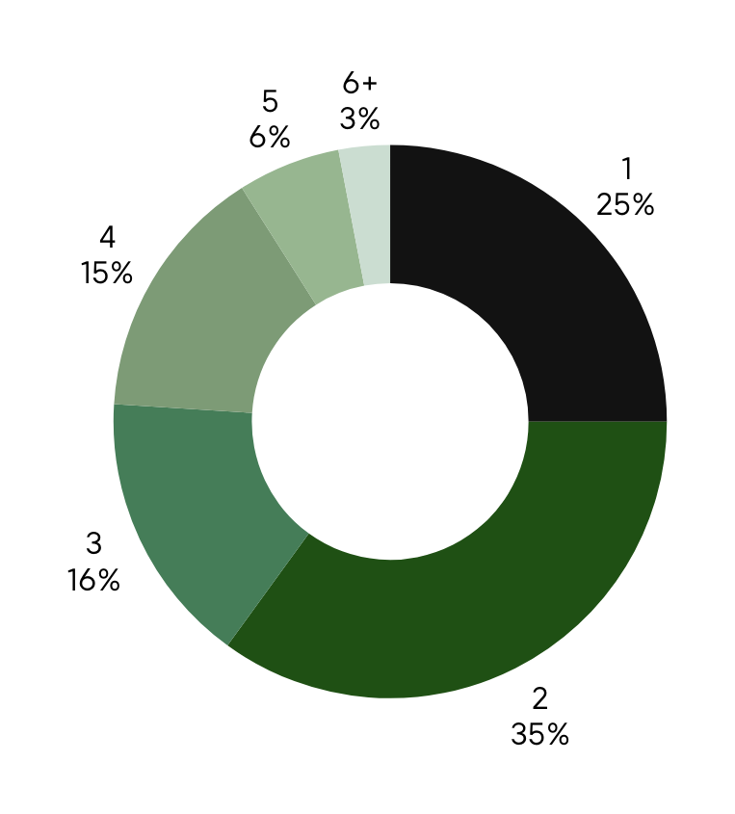
No. of bedrooms
No. of occupants
[5]

Slide 7
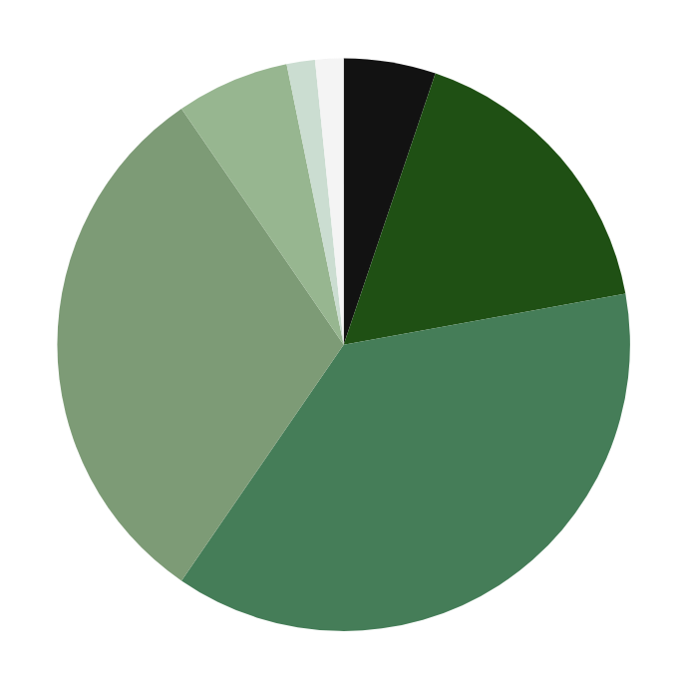
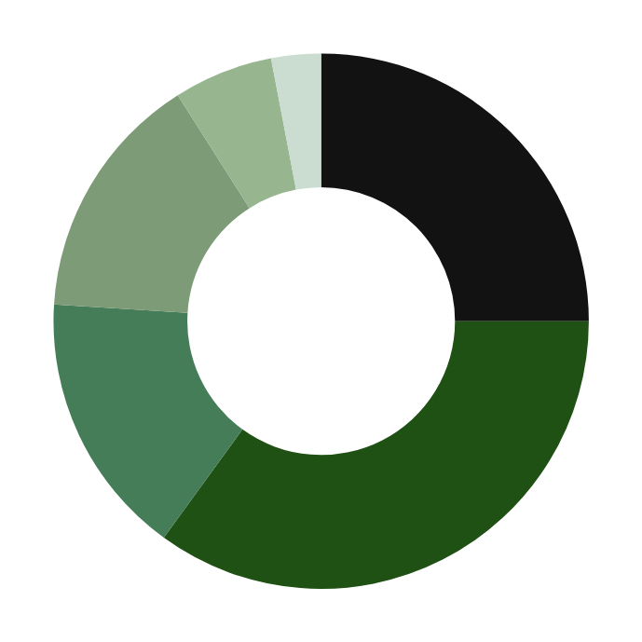
No. of bedrooms
No. of occupants
Inner circle
Outer circle
[5]

Slide 8
UNFAIR
UNFAIR
UNSUSTAINABLE
INEQUITABLE
INACCESSIBLE
OVERPRICED
MARGINALIZING
DISCONNECTED
INADEQUATE
DYSFUNCTIONAL
EXCLUSIONARY
TRANSIENT
FRAGMENTED
DISPARAGING
DISCRIMINATORY
IMBALANCED
[6]

Slide 9
THE COST OF INACTION
1
ECONOMIC
2
SOCIAL
3
ENVIRONMENTAL

Slide 10
THE COST OF INACTION
1
ECONOMIC

Slide 11
1
ECONOMIC
POORER WELFARE SUPPORT OUTCOMES
 | Share of income (jobseeker)
Greater Brisbane | 106%
Rest of QLD | 98%
Rental Affordability for single person on jobseeker (2023)
[7]
Notes:
https://www.theguardian.com/australia-news/2023/nov/14/rent-affordability-index-prices-sydney-melbourne-brisbane-perth-adelaide

Slide 12
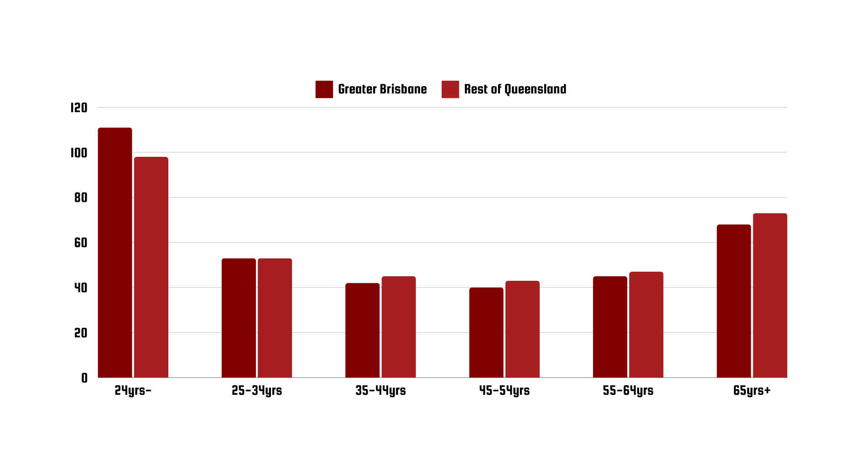
1
ECONOMIC
PERCENTAGE OF INCOME NEEDED FOR WEEKLY RENT, BY AGE GROUPS
Rental Affordability for the average Queenslander (2019-20)
[8]
Notes:
https://www.abs.gov.au/statistics/people/housing/housing-occupancy-and-costs/latest-release

Slide 13
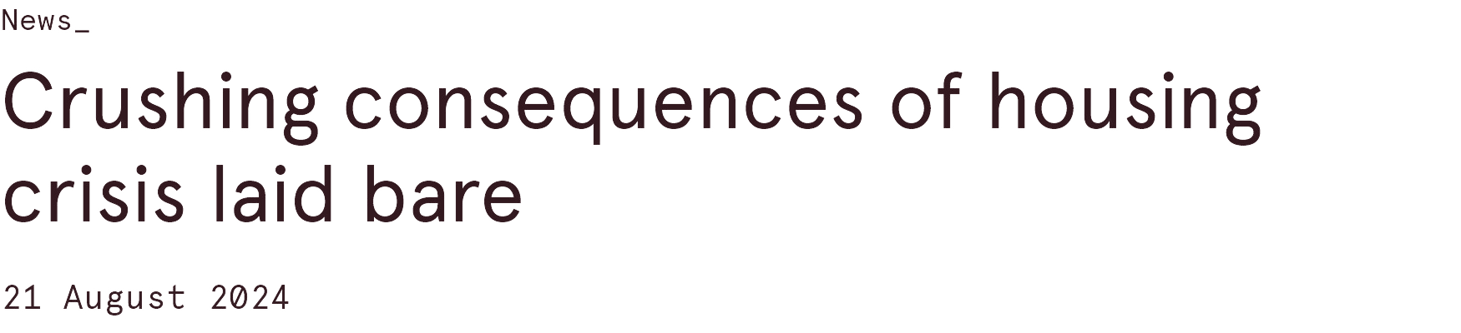

1
ECONOMIC
[9]
Notes:
https://www.abc.net.au/news/2024-01-29/qld-qcoss-cost-of-living-crisis-homelessness-housing/103399434
https://everybodyshome.com.au/resources/housing-criticalthe-role-of-housing-in-solving-critical-skill-shortages-across-the-regions/
https://www.clausiuspress.com/conferences/LNEMSS/EMCG%202021/Y0653.pdf

Slide 14
1
ECONOMIC
Limits labour mobility & talent retention
Sprawling suburbs eat up farmland, affecting agricultural yield
Inefficient housing diverts economic capital & consumer spending from productive sectors, innovation and growth
Limits economic independence
Forces artificial household formations that suppress economic participation
Prices out workers, students & young professionals from economic centers
[10] [11] [12]
Notes:
https://www.abc.net.au/news/2024-01-29/qld-qcoss-cost-of-living-crisis-homelessness-housing/103399434
https://everybodyshome.com.au/resources/housing-criticalthe-role-of-housing-in-solving-critical-skill-shortages-across-the-regions/
https://www.clausiuspress.com/conferences/LNEMSS/EMCG%202021/Y0653.pdf

Slide 15
THE COST OF INACTION
2
SOCIAL

Slide 16
2
SOCIAL
CULTURAL
SEGREGATION
Clustering of appropriate housing for singles, couples, and small families spatially divides peoples.
[5] [6] [7]

Slide 17
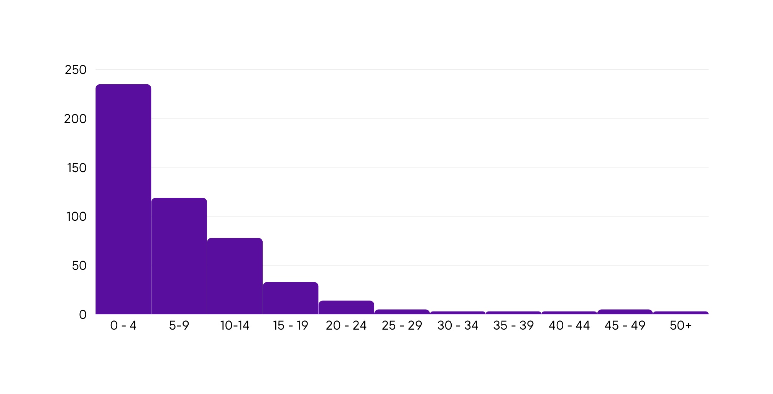
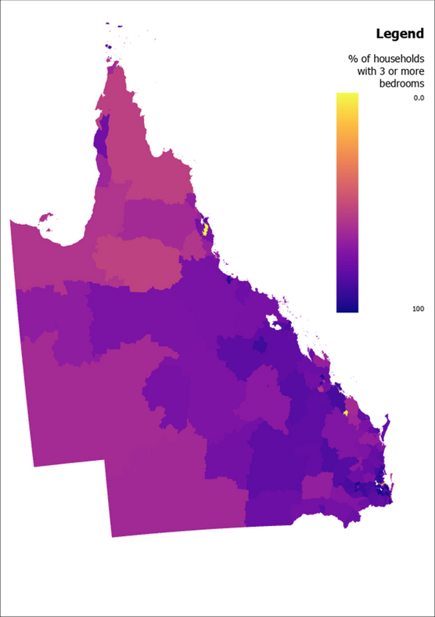
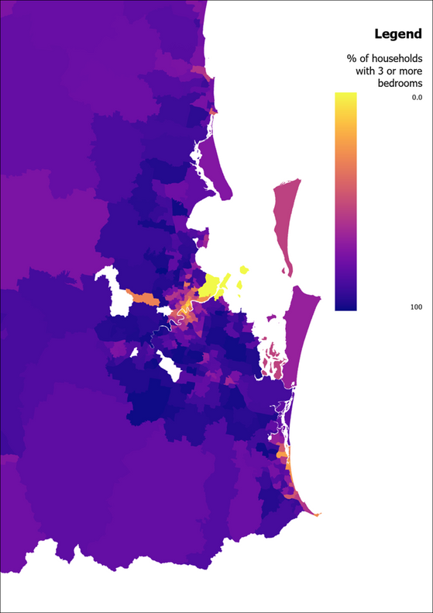
2
SOCIAL
Sum of SA2s
% of dwellings with 0-2 bedrooms
Frequency of 0-2 bedroom dwellings across Queensland
[13]

Slide 18
2
SOCIAL
Top suburbs with 3 or more bedrooms per dwelling
Rank | Suburb | %
1 | Westlake | 98.57
2 | Eatons Hill | 98.55
3 | Springfield | 97.98
4 | Wakerley | 97.96
5 | Flagstone (West) - New Beith | 97.87
6 | Fig Tree Pocket | 97.85
7 | Regents Park - Heritage Park | 97.67
8 | Pacific Pines - Gaven | 97.52
9 | Middle Park - Jamboree Heights | 97.41
10 | Calamvale - Stretton | 97.38
Rank | Suburb | %
11 | Pallara - Willawong | 97.35
12 | Burpengary - East | 97.24
13 | Sheldon - Mount Cotton | 97.24
14 | Parkwood | 97.07
15 | Doolandella | 97.04
16 | Bellbowrie - Moggill | 96.88
17 | Annandale (Qld) | 96.70
18 | Munruben - Park Ridge South | 96.63
19 | Bridgeman Downs | 96.59
20 | Narangba | 96.57
Rank | Suburb | %
21 | Ormeau (West) - Yatala | 96.56
22 | Flagstone (East) - Riverbend | 96.52
23 | Augustine Heights - Brookwater | 96.47
24 | Jindalee - Mount Ommaney | 96.42
25 | Parkinson - Drewvale | 96.38
26 | Chapel Hill | 96.28
27 | Telina - Toolooa | 96.27
28 | Burdell - Mount Low | 96.24
29 | Gowrie (Qld) | 96.14
30 | Rochedale - Burbank | 96.09
[13]
Notes:
122 > 90%
266 > 80%

Slide 19

2
SOCIAL
Notes:
Look how Macaulay Culkin feels about the real estate market, knowing he'll be all alone in a giant family house, forever.

Slide 20
2
SOCIAL
The lack of safe housing puts the physical and mental health of people at risk
Pushes at-risk peoples into homelessness
Reduces social inclusion & mobility
Reduces opportunity equality
A barrier to finding and holding down employment and engaging in education
Can force people to cut spending on other essentials
Fuels isolation and mental health crisis
Traps victims in domestic violence
Perpetuates poverty
Poor housing choices are known to contribute greatly to the loneliness epidemic
[14] [15] [16]

Slide 21
THE COST OF INACTION
3
ENVIRONMENTAL

Slide 22
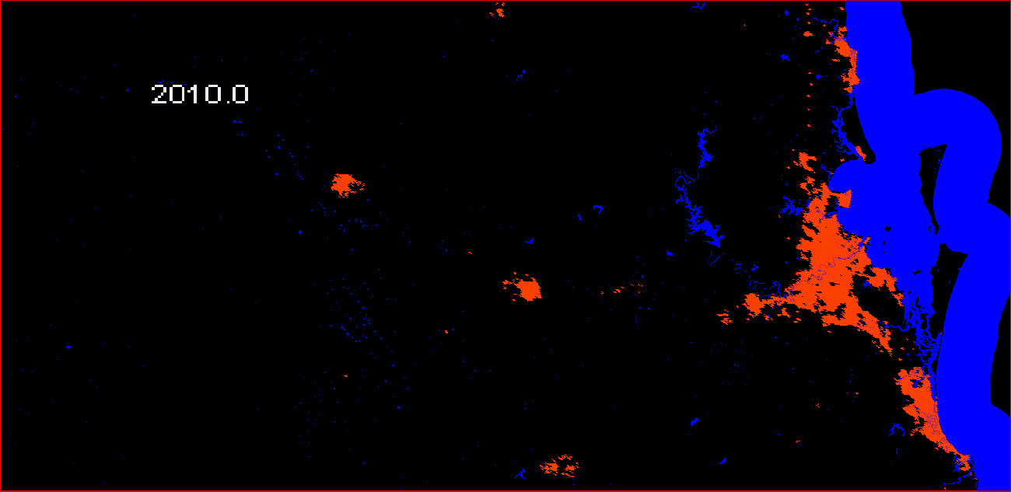
3
ENVIRONMENTAL
Larger homes =
  greater greenhouse gas emissions for both construction & operation
  increased material consumption
  greater contributions to low-density sprawl
  smaller sized houses correlate to lower waste output
[17] [18] [19] [20]
Notes:
https://www.sciencedirect.com/science/article/pii/S0304393206001279#aep-abstract-id7
http://anzasca.net/wp-content/uploads/2015/12/ANZAScA_2009_Fuller_Crawford_Leonard.pdf
75% of Queensland households have a spare bedroom
http://carleton-wp-production.s3.amazonaws.com/uploads/sites/111/2019/07/charlie_kilman_tinyhouses__4_.pdf

Slide 23
THE SOLUTION
GOOD DESIGN
BOLD POLICY

Slide 24
1
MANDATING/ENCOURAGING
DIVERSITY IN GROWTH AREAS
[a] [6] [7]
Notes:
Utilization of

Slide 25
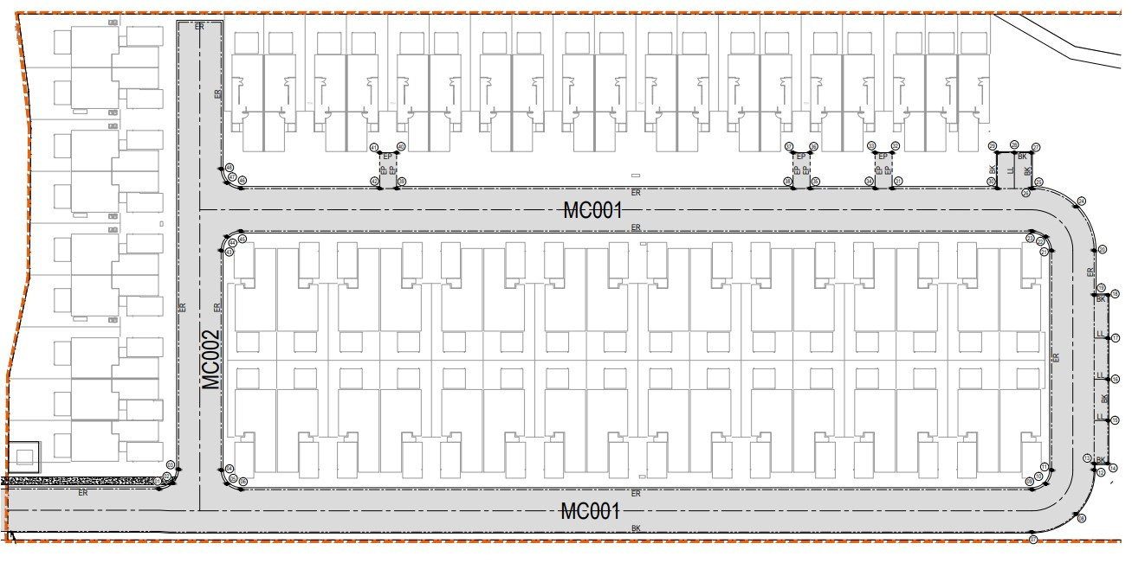
[21]
Notes:
https://www.openlot.com.au/verde-residences-pallara

Slide 26
MICRO-LOTS
TINY HOME COMMUNITIES
BUNGALOW COURTS
ROW HOUSES
TOWNHOUSES
APARTMENTS
KHRUSHCHEVKAS

Slide 27
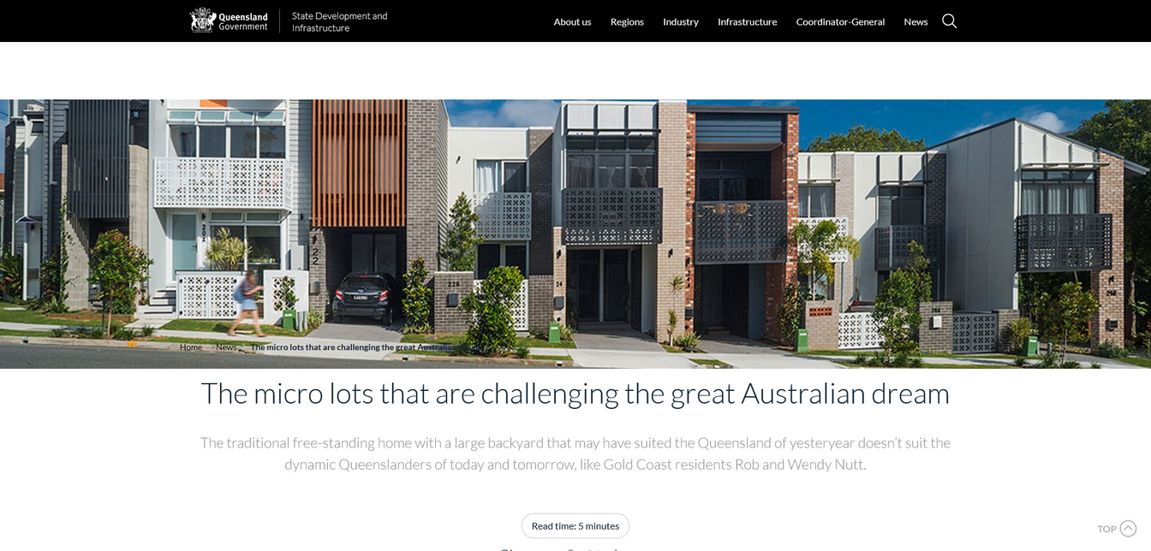
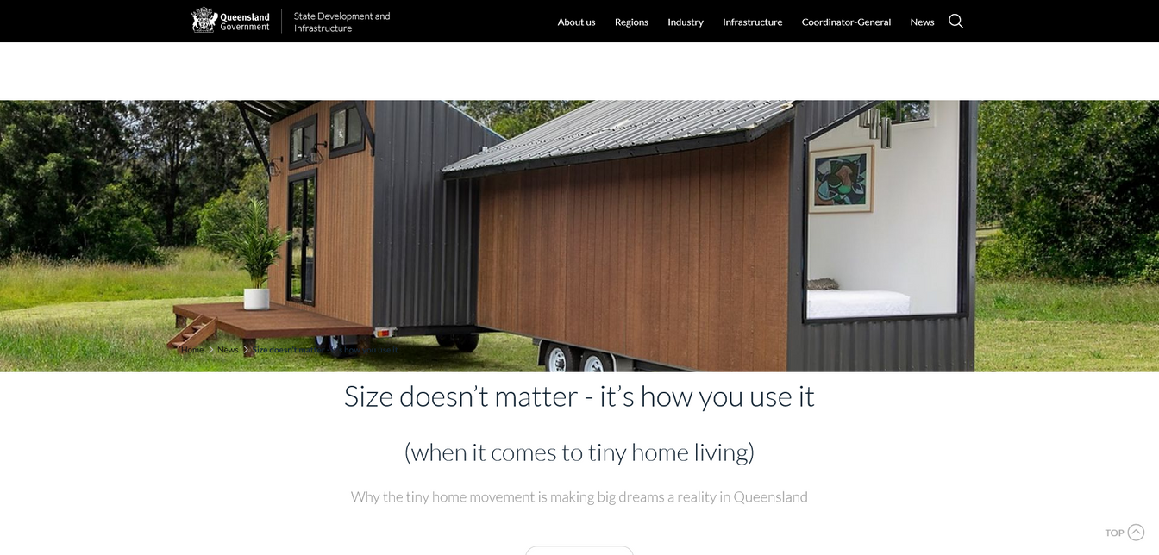
[22] [23]
Notes:
Utilization of

Slide 28
MISSING MIDDLE
HOLISTIC PLANNING

Slide 29
2
PUBLIC-PUBLIC, OR
PUBLIC-PRIVATE PARTNERSHIPS
[a] [6] [7]
Notes:
Utilization of

Slide 30
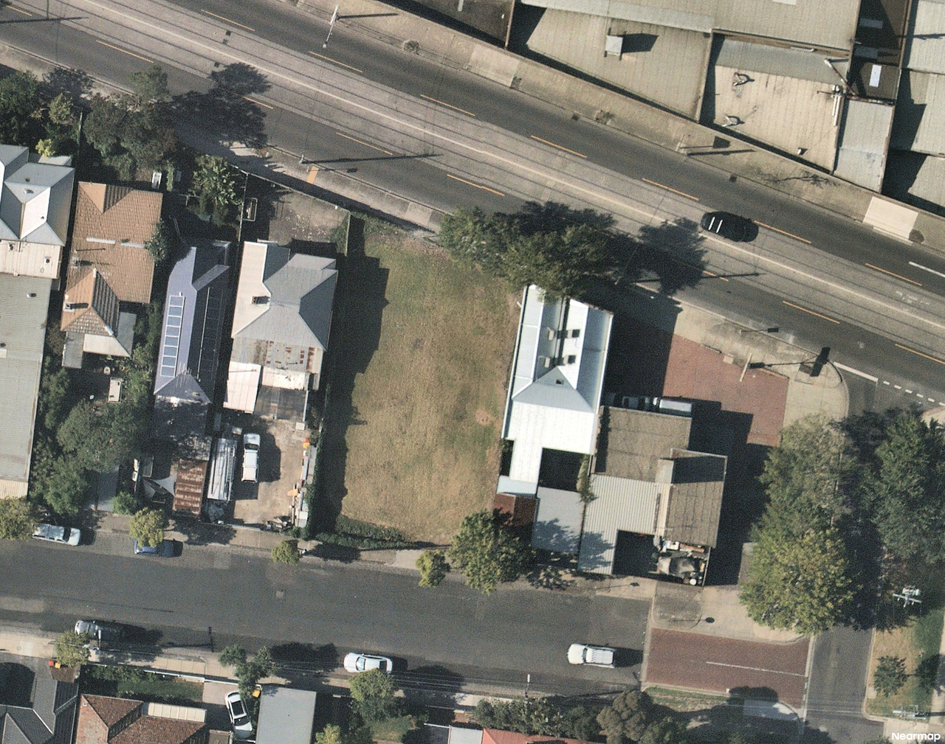
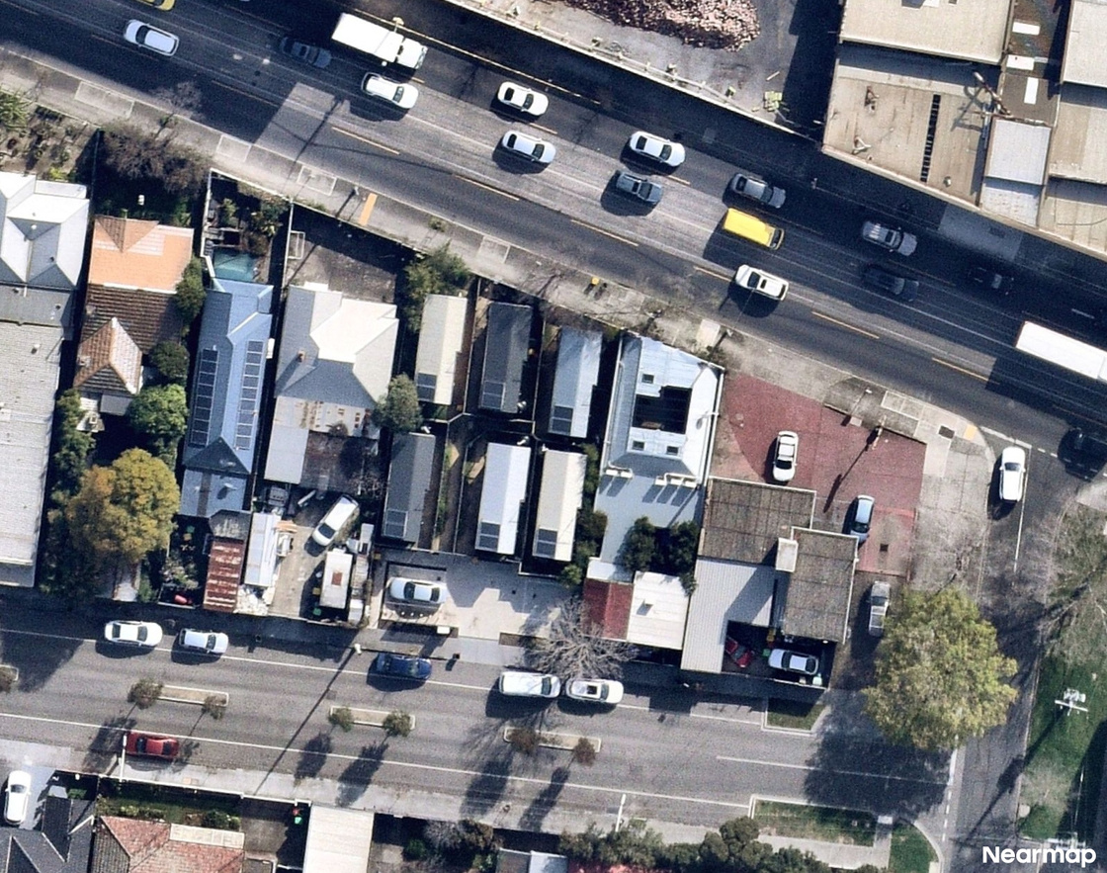
->
Case Example: Launch Housing - Harris Transportable Housing Project
Partnership between Harris Capital, VicRoads, Victorian Property Fund & others
[24] [25]
Notes:
Utilization of

Slide 31
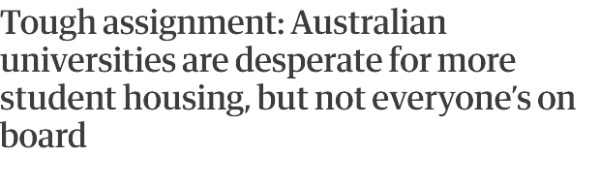
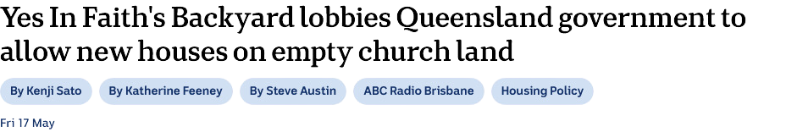


  Expanding the Inclusionary Planning Pilot's Mandatory Inclusionary Planning model to also require a fixed percentage of smaller sized homes in development areas as a condition of the planning approval. Affordability is one aspect, but so too is appropriate dwelling stock.
  Leverage other existing iniatives to fill demand for small dwellings
[26] [27] [28]

Slide 32
3
PUBLIC HOUSING THAT IS
BUILT TO OWN
[a] [6] [7]
Notes:
Utilization of

Slide 33
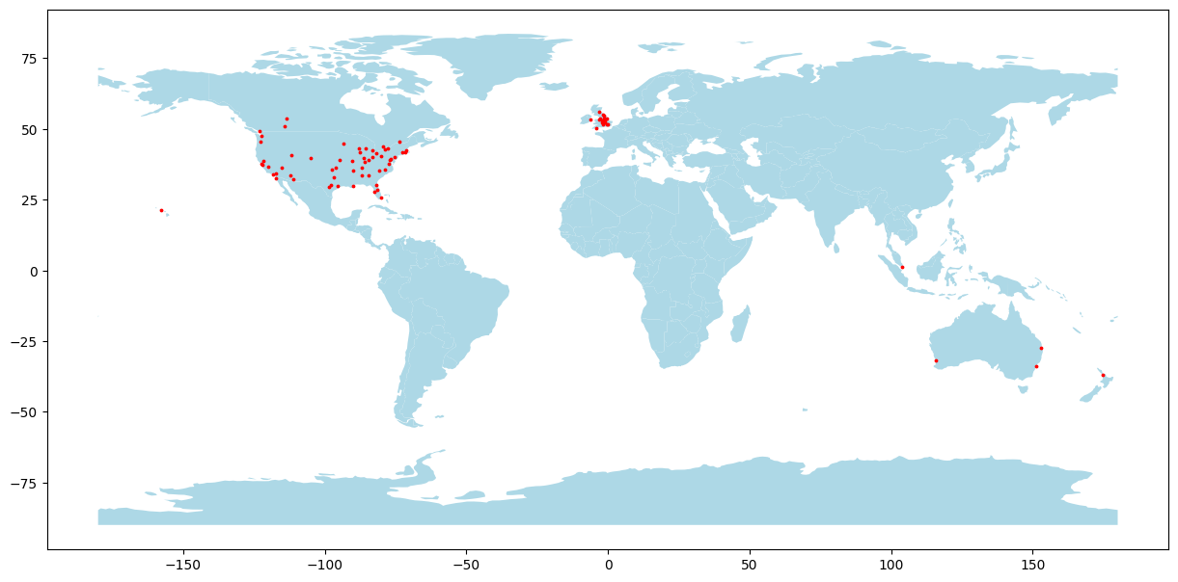
HOUSING MARKETS RANKED BY AFFORDABILITY: MOST AFFORDABLE TO LEAST AFFORDABLE
Median Multiple (Median House Price/Median Household Income): 2023: Third Quarter
Rank | Nation | Metropolitan Market | Median Multiple
------ | --------- | ------------------- | ----------------
1 | U.S. | Pittsburgh, PA | 3.1
2 | U.S. | Rochester, NY | 3.4
...
...
11 | Singapore | Singapore | 3.8
77 | U.S. | New York, NY-NJ-PA | 7.0
= 80 | Australia | Brisbane, QLD | 8.1
= 80 | U.S. | Miami, FL | 8.1
= 80 | U.K. | Greater London | 8.1
...
93 | Australia | Sydney, NSW | 13.8
94 | China | Hong Kong | 16.7
[29]
Notes:
https://fcpp.org/wp-content/uploads/2024-Demographia-International-Housing-Affordability-2.pdf

Slide 34
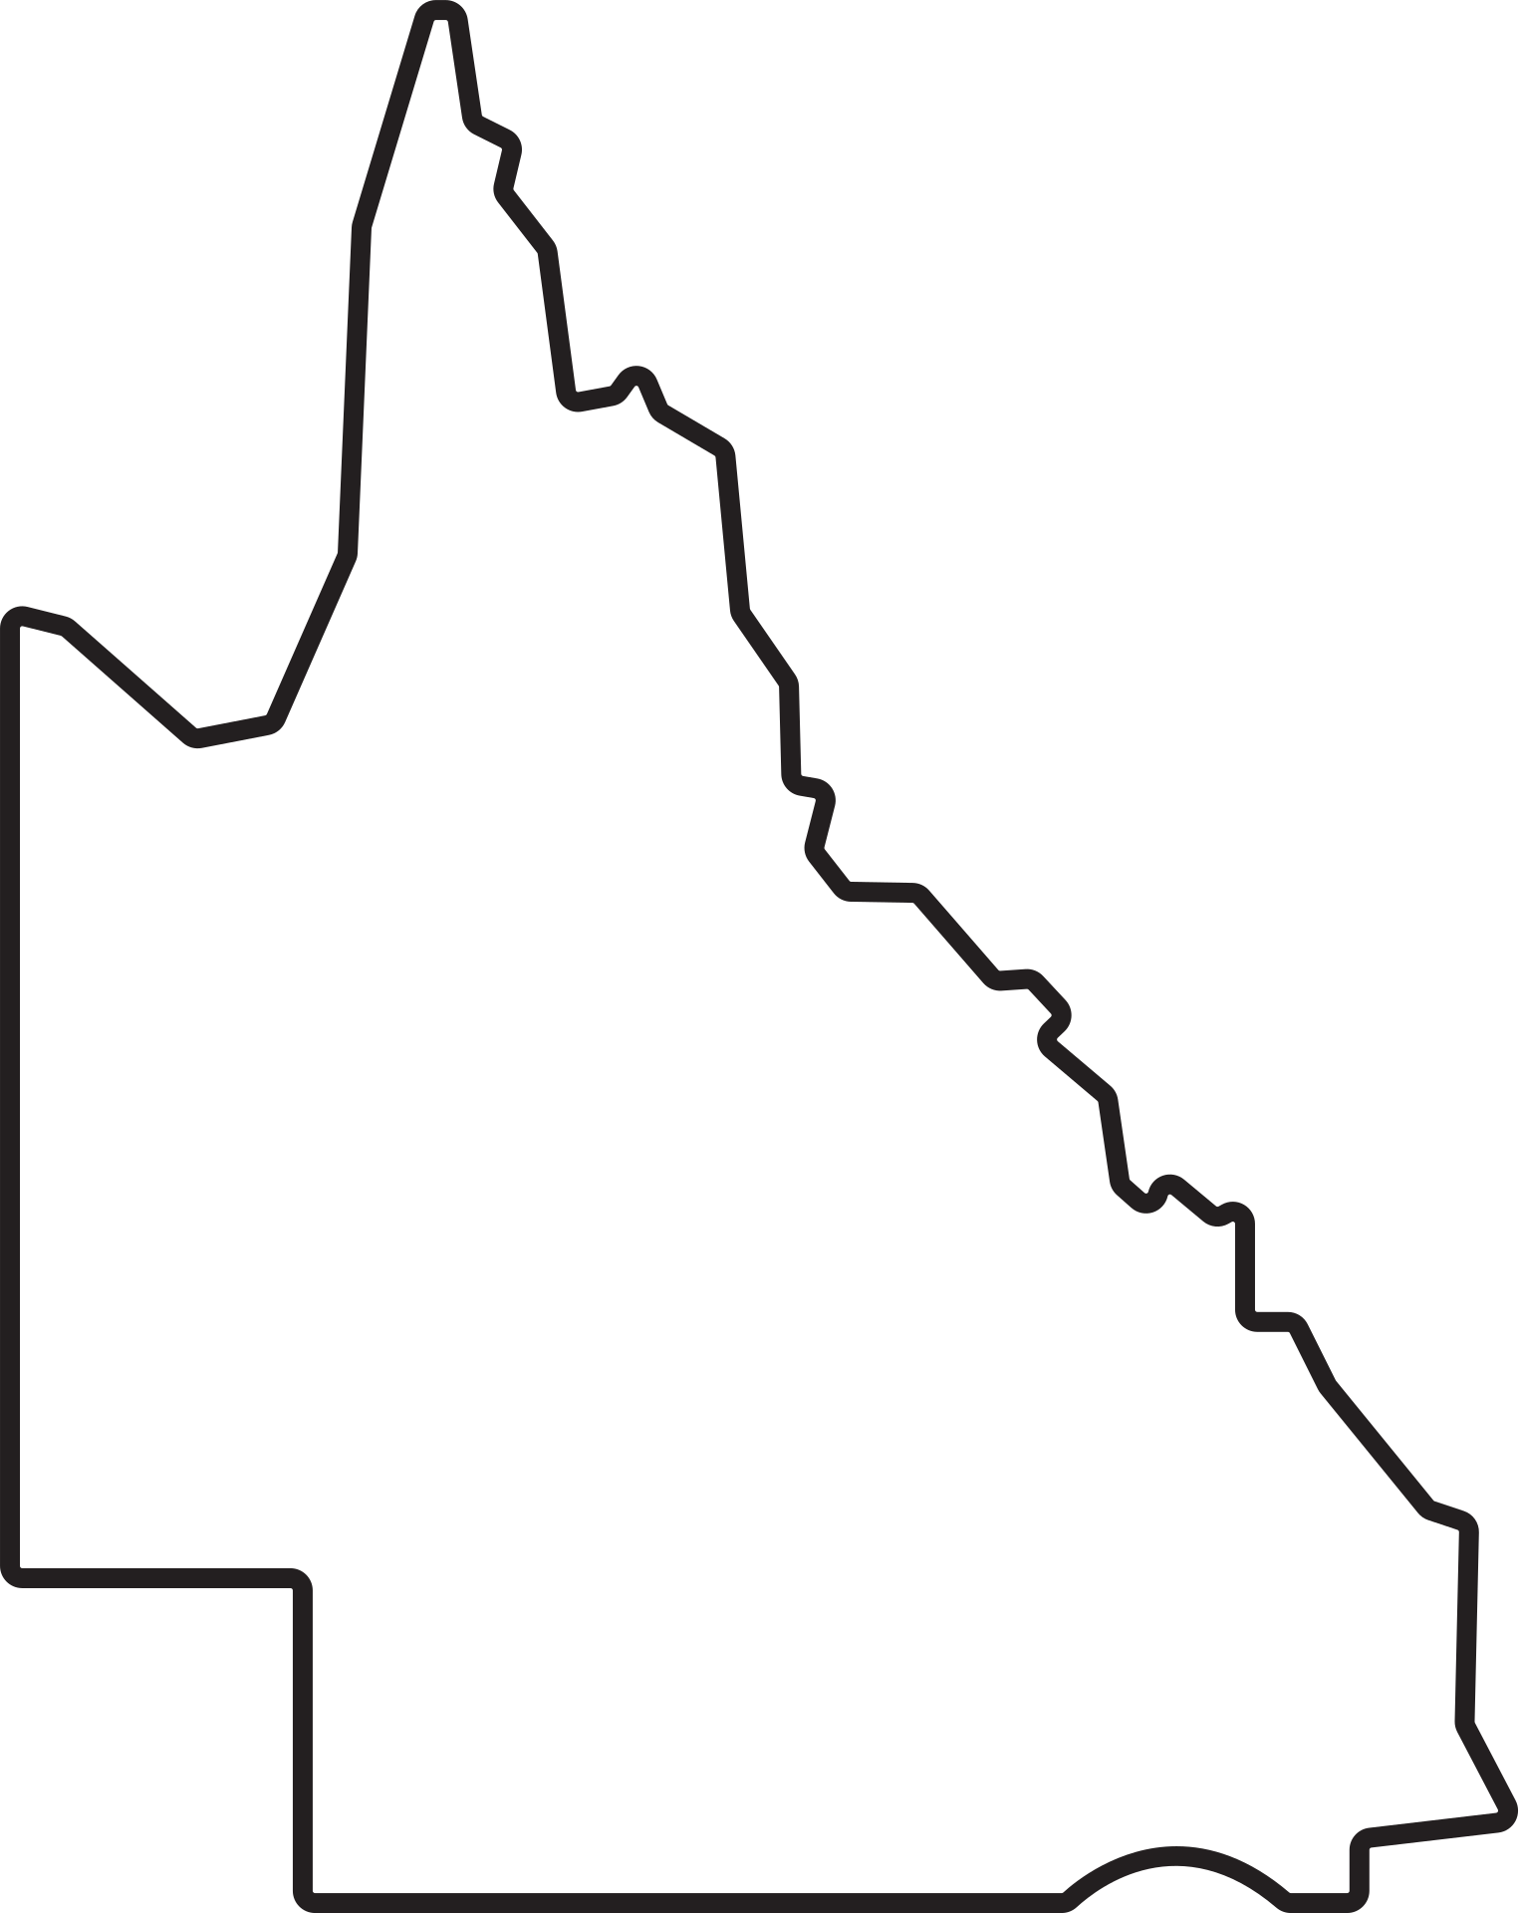
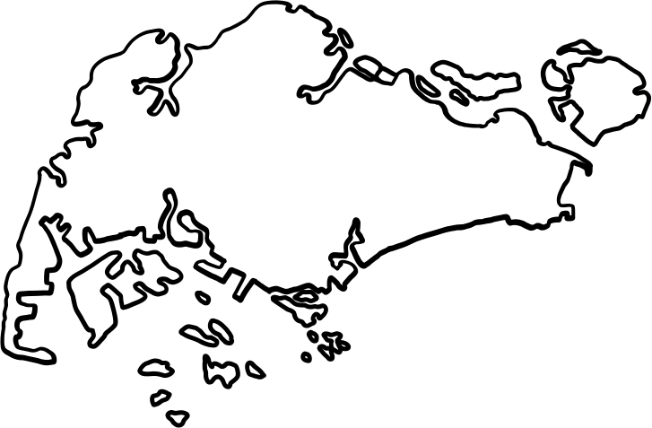
SINGAPORE
QUEENSLAND
Overall population: 5.9 million
Size: 734 square kilometres (1/2,500 the size of Queensland)
Overall population: 5.6 million
Size: 1,727,000 square kilometres
× 2,350 = 1
[30] [31]
Notes:
https://www.population.gov.sg/files/media-centre/publications/population-in-brief-2023.pdf
https://www.qgso.qld.gov.au/statistics/theme/population/population-estimates/state-territories/qld-population-counter

Slide 35
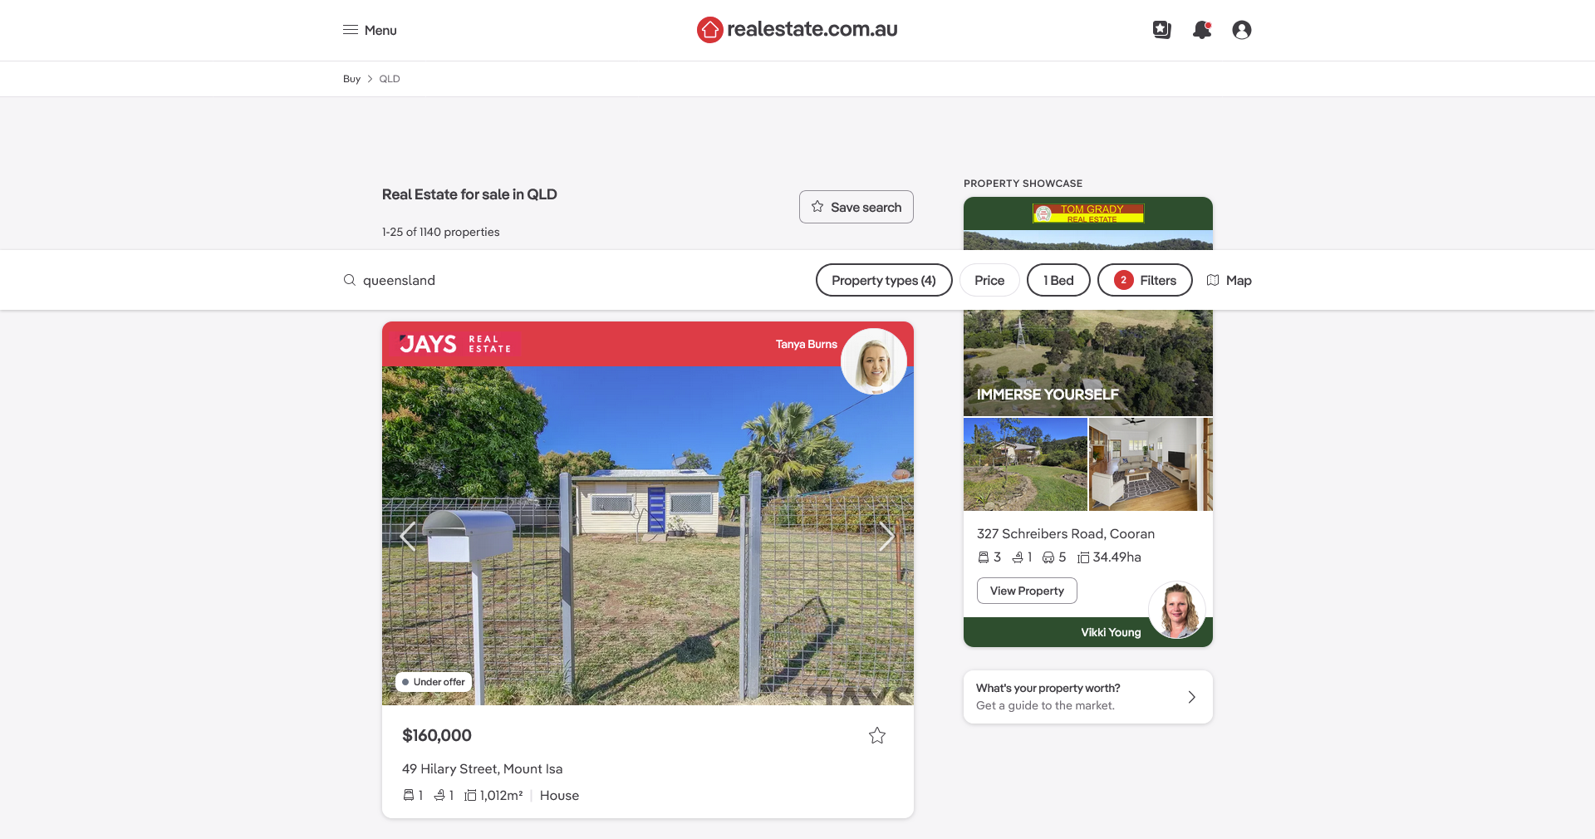
A STATE MORE PEOPLE CAN CALL HOME
[a] [6] [7]
Notes:
Utilization of

Slide 36
QUEENSLAND'S HOUSING MISMATCH: A GROWING CRISIS
DATE
Eli J. Rifai
11/10/2024
THANK YOU
One size does not fit all: Our shortage of smaller homes
THE UNIVERSITY OF QUEENSLAND
PRODUCED FOR
3rd Year
Bachelor of Regional & Town Planning Student
Queensland Government Planning Award Wicked Planning Problem

Slide 37
WORKS CITED
[1] | Residential Tenancies Authority. (2024). Median rents quarterly data. Retrieved from https://www.rta.qld.gov.au/forms-resources/median-rents-quick-finder/median-rents-quarterly-data
[2] | Australian Bureau of Statistics (ABS). (2024). Household and Family Projections, Australia. Canberra: Australian Bureau of Statistics.
[3] | Australian Bureau of Statistics (ABS). (2021). Australian Bureau of Statistics Aggregates 1961-2021. Canberra: Australian Bureau of Statistics.
[4] | Tilley, E. (2024, July 31). It's official: We have the biggest homes in the world - and a supply problem. Realestate.com.au. Retrieved from https://www.realestate.com.au/news/its-official-we-have-the-biggest-homes-in-the-world-and-a-supply-problem
[5] | Australian Bureau of Statistics (ABS). (2021). Housing: Census. Canberra: Australian Bureau of Statistics.
[6] | Wetzstein, S. (2017). The global urban housing affordability crisis. Urban Studies, 54(14), 3159-3177. https://doi.org/10.1177/0042098017711649
[7] | Kelly, C. (2023, November 13). Renters on JobSeeker need at least 78% of income for one-bedroom apartment in capital cities, report finds. The Guardian. Retrieved from https://www.theguardian.com/australia-news/2023/nov/14/rent-affordability-index-prices-sydney-melbourne-brisbane-perth-adelaide
[8] | Australian Bureau of Statistics (ABS). (2022). Housing Occupancy and Costs, July 2017 - June 2018. Retrieved from www.abs.gov.au
[9] | The University of Sydney. (2024, August 21). Crushing consequences of housing crisis laid bare. Retrieved from The University of Sydney. (2024). Crushing consequences of housing crisis laid bare. [online] Available at: https://www.sydney.edu.au/news-opinion/news/2024/08/21/crushing-consequences-of-housing-crisis-laid-bare.html.
[10] | Hyam, R. (2024, January 29). Homelessness now "status quo" for low-income Queenslanders, as Brisbane records highest rent, energy hikes. ABC News. Retrieved from https://www.abc.net.au/news/2024-01-29/qld-qcoss-cost-of-living-crisis-homelessness-housing/103399434
[11] | Everybody's Home. (2023). Housing Critical: The role of housing in solving critical skill shortages across the regions. Retrieved from https://everybodyshome.com.au/resources/housing-criticalthe-role-of-housing-in-solving-critical-skill-shortages-across-the-regions/

Slide 38
WORKS CITED
[12] | Liu, Y., Tan, J., Shen, J., & Zhang, L. (2021). Assessing the Influence of Public Housing in Singapore. Retrieved from Liu, Y., Tan, J., Shen, J. and Zhang, L. (n.d.). Assessing the Influence of Public Housing in Singapore. [online] Available at: https://www.clausiuspress.com/conferences/LNEMSS/EMCG%202021/Y0653.pdf [Accessed 10 Oct. 2024].
[13] | Australian Bureau of Statistics. (2021). 2021Census_G35_QLD_SA2 & 2021Census_G41_QLD_SA2 Datacubes. Canberra: Australian Bureau of Statistics.
[14] | Warren, S., & McAuliffe, D. (2021). Homelessness and domestic and family violence in Queensland mining communities: The experiences of women and families accessing safe and affordable housing. The Extractive Industries and Society, 8(4), 100974. https://doi.org/10.1016/j.exis.2021.100974
[15] | Australian Institute of Health and Welfare (AIHW). (2024). Housing affordability. Retrieved from Australian Institute of Health and Welfare (AIHW), 2024. Housing affordability. Viewed 7 October 2024. Available at: https://www.aihw.gov.au/reports/australias-welfare/housing-affordability.
[16] | Australian Government Treasury. (2024). Impact analysis: Supporting social and affordable housing under the Housing Australia Future Fund and the National Housing Accord. Retrieved from Australian Government Treasury, 2024. Impact analysis: Supporting social and affordable housing under the Housing Australia Future Fund and the National Housing Accord. Available at: http://creativecommons.org/licenses/by/3.0/au/legalcode (Accessed: 29 September 2024).
[17] | Moseman, A. (2022). How much CO2 is emitted by building a new house? MIT Climate Portal. Retrieved from Moseman, A. (2022). How much CO2 is emitted by building a new house? [online] MIT Climate Portal. Available at: https://climate.mit.edu/ask-mit/how-much-co2-emitted-building-new-house.
[18] | Campbell, J. Y., & Cocco, J. F. (2007). How do house prices affect consumption? Evidence from micro data. Journal of Monetary Economics, 54(3), 591-621. Campbell, J.Y. and Cocco, J.F. (2007). How do house prices affect consumption? Evidence from micro data. Journal of Monetary Economics, 54(3), pp.591–621. doi:https://doi.org/10.1016/j.jmoneco.2005.10.016.
[19] | Fuller, R., Crawford, R., & Leonard, D. (2009). What is wrong with a big house? Retrieved from Fuller, R., Crawford, R. and Leonard, D. (2009). What is wrong with a big house? [online] Available at: http://anzasca.net/wp-content/uploads/2015/12/ANZAScA_2009_Fuller_Crawford_Leonard.pdf [Accessed 10 Oct. 2024].

Slide 39
WORKS CITED
[19] | Fuller, R., Crawford, R., & Leonard, D. (2009). What is wrong with a big house? Retrieved from Fuller, R., Crawford, R. and Leonard, D. (2009). What is wrong with a big house? [online] Available at: http://anzasca.net/wp-content/uploads/2015/12/ANZAScA_2009_Fuller_Crawford_Leonard.pdf [Accessed 10 Oct. 2024].
[20] | Kilman, C. (2016). Small House, Big Impact: The Effect of Tiny Houses on Community and Environment. Undergraduate Journal of Humanistic Studies, 2. Retrieved from http://carleton-wp-production.s3.amazonaws.com/uploads/sites/111/2019/07/charlie_kilman_tinyhouses__4_.pdf
[21] | OpenLot.com.au. (2021). Verde Residences - 204 Wadeville Street, Pallara QLD 4110. [online] Available at: https://www.openlot.com.au/verde-residences-pallara [Accessed 10 Oct. 2024].
[22] | Queensland Department of State Development, Infrastructure, Local Government and Planning. (2023). The micro lots that are challenging the great Australian dream. Retrieved from https://www.statedevelopment.qld.gov.au/news/the-micro-lots-that-are-challenging-the-great-australian-dream
[23] | Queensland Department of State Development, Infrastructure, Local Government and Planning. (2024). Size doesn't matter. Retrieved from https://www.statedevelopment.qld.gov.au/news/size-doesnt-matter
[24] | Launch Housing. (2019). Harris Transportable Housing Project. Retrieved from https://www.launchhousing.org.au/harris-transportable-housing-project
[25] | Hansen Partnership. (2021). Harris Transportable Housing Project - Hansen Partnership. [online] Available at: https://hansenpartnership.com.au/projects/harris-transportable-housing-project/ [Accessed 10 Oct. 2024].
[26] | Planning (Inclusionary Zoning Strategy) Amendment Bill 2023 (Qld). (2023). Queensland Legislation. Available at: https://www5.austlii.edu.au/au/legis/qld/bill/pzsab2023524/ (Accessed: 10 October 2024).
[27] | Sato, K., Feeney, K., & Austin, S. (2024). Yes In Faith’s Backyard lobbies Queensland government to allow new houses on empty church land. ABC News. Retrieved October 10, 2024, from https://www.abc.net.au/news/2024-05-17/yes-in-faith-backyard-homes-on-church-land-queensland/103855258
[28] | Cassidy, C. (2024). Australian universities face student housing crisis amid surging demand. The Guardian. Retrieved October 10, 2024, from https://www.theguardian.com/australia-news/article/2024/jun/09/australian-universities-student-housing

Slide 40
WORKS CITED
[28] | Cassidy, C. (2024). Australian universities face student housing crisis amid surging demand. The Guardian. Retrieved October 10, 2024, from https://www.theguardian.com/australia-news/article/2024/jun/09/australian-universities-student-housing
[29] | Cox, W. and Pavletich, H. (2024). 2024 Demographia International Housing Affordability. Frontier Centre for Public Policy. Available at: https://fcpp.org/wp-content/uploads/2024-Demographia-International-Housing-Affordability-2.pdf (Accessed: 10 October 2024).
[30] | National Population and Talent Division. (2023). Population in Brief 2023. Singapore: Government of Singapore. Available at: https://www.population.gov.sg/files/media-centre/publications/population-in-brief-2023.pdf (Accessed: 10 October 2024).
[31] | Queensland Government Statistician’s Office. (2024). Queensland Population Counter. Queensland Government. Available at: https://www.qgso.qld.gov.au/statistics/theme/population/population-estimates/state-territories/qld-population-counter (Accessed: 10 October 2024).
[32] | realestate.com.au. (2024). Queensland properties for sale - 1 bedroom maximum. Available at: https://www.realestate.com.au/buy/in-queensland/list-1?maxBeds=1&includeSurrounding=false&activeSort=relevance&source=refinement (Accessed: 10 October 2024).

